Slide 1
CSE-2021-SD
Institute/School Name | Chitkara University Institute of Engineering and Technology
Department Name | Department of Computer Science & Engineering
Programme Name | Bachelor of Engineering (B.E.), Computer Science & Engineering
Course Name | SYSTEM DESIGN | Session | 2023-2024
Course Code | CS254H | Semester/Batch | 5th/2021
L-T-P (Per Week) | 2-0-0 | Course Credits | 02
Course Coordinator | Dr. Parul

Slide 2
Course Outcomes
CLO01 | Distinguish concepts related to processes, threads, process scheduling, race conditions and critical sections.
CLO02 | Examine and categorize various memory management techniques like caching, paging, segmentation, virtual memory, and thrashing; Design and implement file management system.
CLO03 | Construct the SQL queries for given specifications.
CLO04 | Explain the functions of the different layer of the OSI Protocol.

Slide 3
CLO-01 Lecture -1-18

Slide 4
Basic Terminology
System data Information Knowledge
Computer Processing Memory Number
Digit Hardware Software Problem Statement Logic Solution
Network

Slide 5
Computer and Its Components
Computer :
Hardware : Physical components of computer
1. Input : keyboard, mouse, mic, touch screen
scanner, joy stick, web cam, track ball
2. Memory and processing : RAM, ROM , Pen drive, DVD, CD, processor .
3. output device : Monitor, printer, projector, speakers, head phone
Software : It is part of computer which enable hardware of computers to work.
System software : OS:
Utility software:
Application software:

Slide 6
Operating System
An operating system is software that manages a computer’s hardware.
It also provides a basis for application programs and acts as an intermediary between the computer user and the computer hardware.
A computer system can be divided roughly into four components:
Hardware,
Operating system
Application programs
User

Slide 7
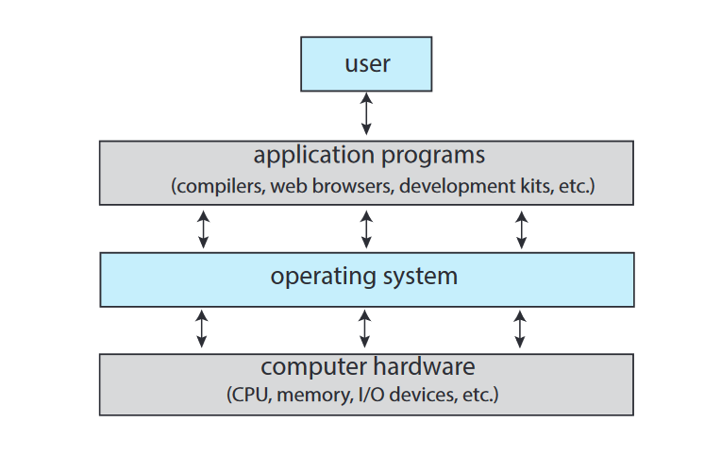
Operating System

Slide 8
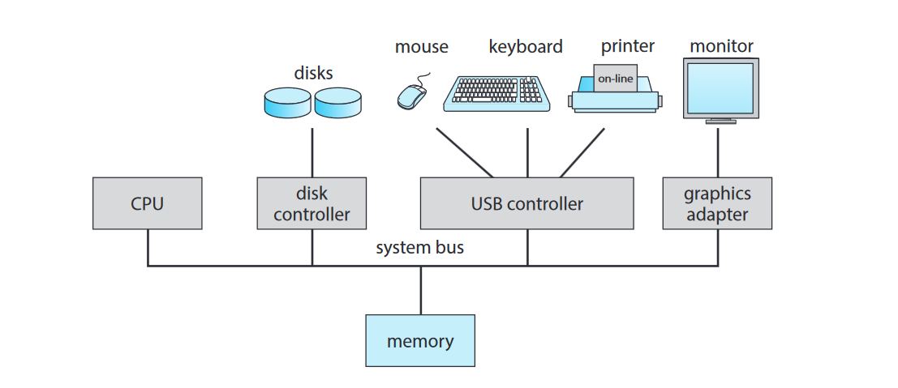
Computer-System Organization

Slide 9
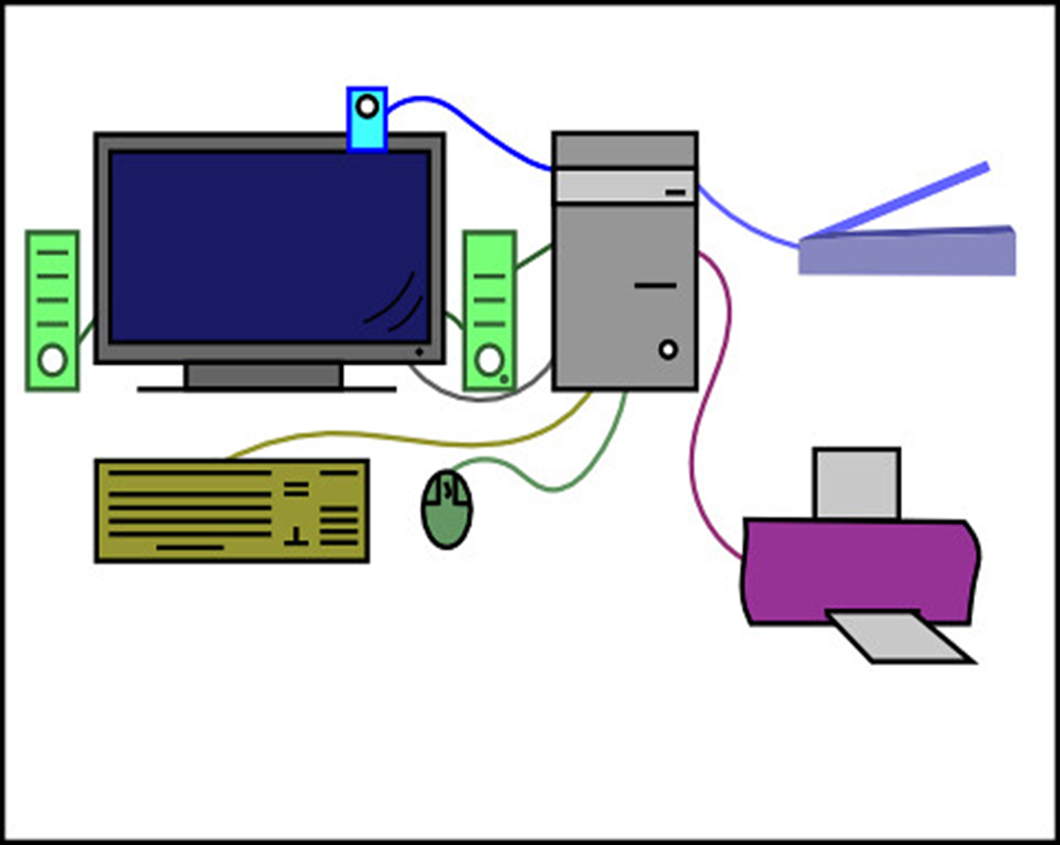

Slide 10
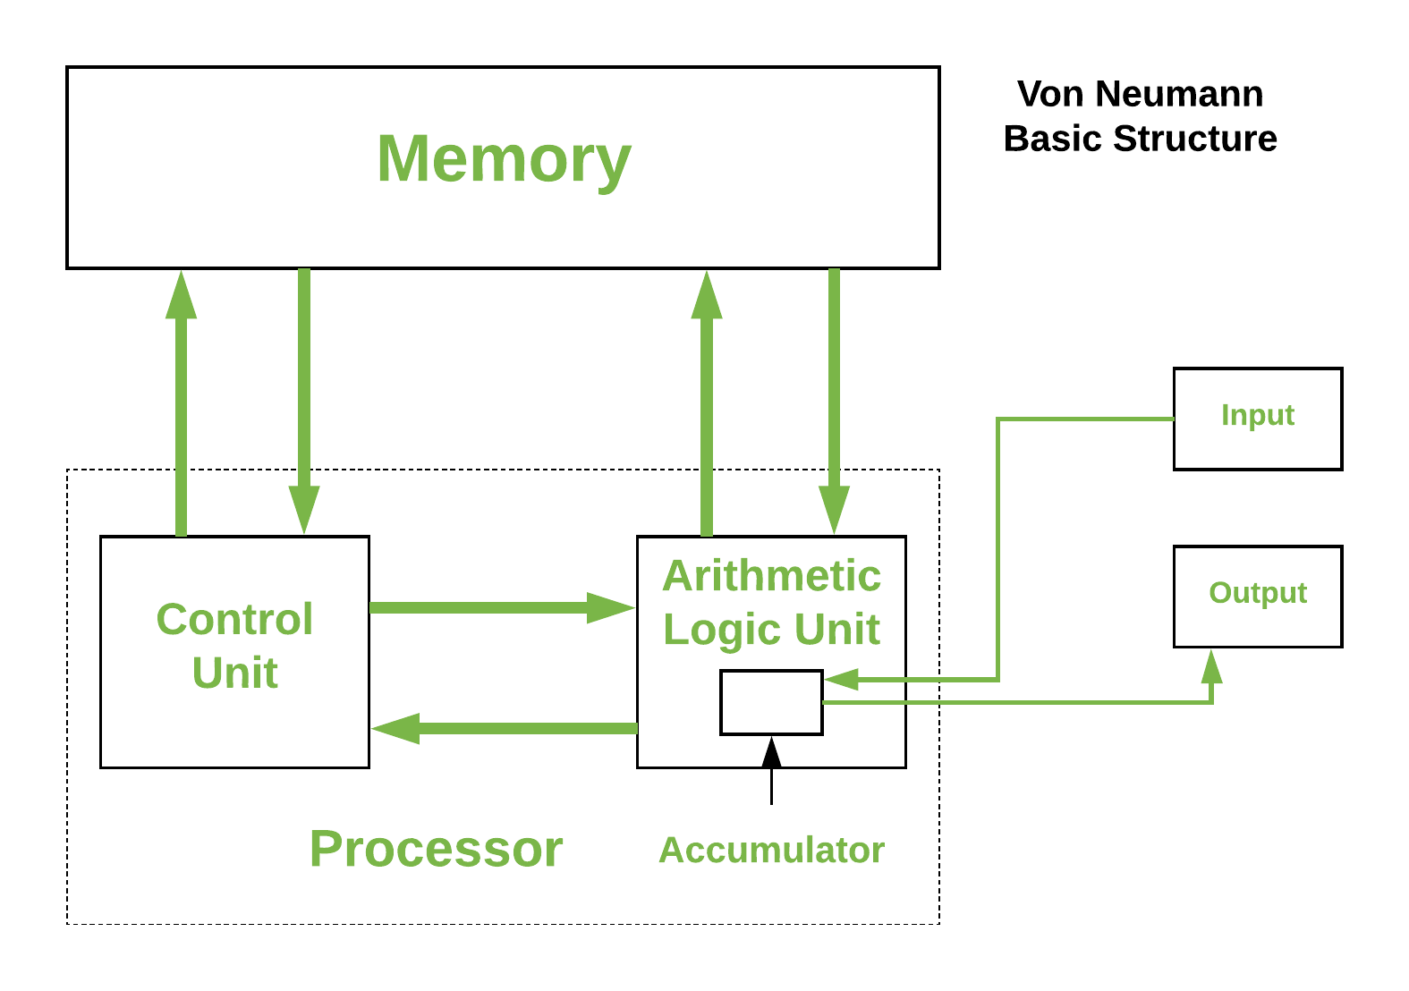
Von Neumann Basic Structure

Slide 11
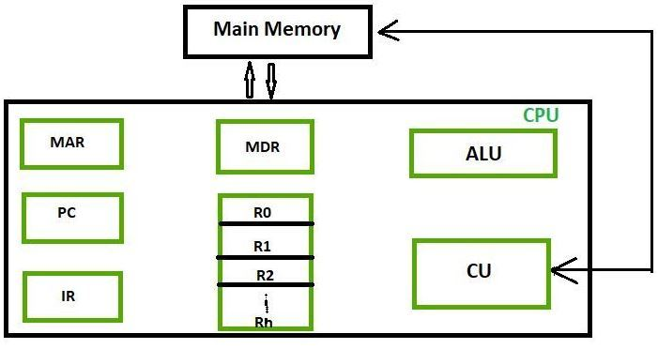
Registers
Registers are a type of computer memory built directly into the processor or CPU (Central Processing Unit) that is used to store and manipulate data during the execution of instructions.

Slide 12
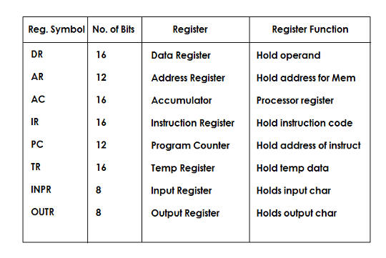
Registers

Slide 13
Registers
Accumulator: This is the most frequently used register used to store data taken from memory. It is in different numbers in different microprocessors.
Memory Address Registers (MAR): It holds the address of the location to be accessed from memory. MAR and MDR (Memory Data Register) together facilitate the communication of the CPU and the main memory.
Memory Data Registers (MDR): It contains data to be written into or to be read out from the addressed location.
General Purpose Registers: These are numbered as R0, R1, R2….Rn-1, and used to store temporary data during any ongoing operation. Its content can be accessed by assembly programming. Modern CPU architectures tends to use more GPR so that register-to-register addressing can be used more, which is comparatively faster than other addressing modes.
Program Counter (PC): Program Counter (PC) is used to keep the track of execution of the program. It contains the memory address of the next instruction to be fetched. PC points to the address of the next instruction to be fetched from the main memory when the previous instruction has been successfully completed. Program Counter (PC) also functions to count the number of instructions. The incrementation of PC depends on the type of architecture being used. If we are using 32-bit architecture, the PC gets incremented by 4 every time to fetch the next instruction.

Slide 14
Registers
Instruction Register (IR): The IR holds the instruction which is just about to be executed. The instruction from PC is fetched and stored in IR. As soon as the instruction in placed in IR, the CPU starts executing the instruction and the PC points to the next instruction to be executed.
Condition code register ( CCR ) : Condition code registers contain different flags that indicate the status of any operation. for instance lets suppose an operation caused creation of a negative result or zero, then these flags are set high accordingly.
Carry C: Set to 1 if an add operation produces a carry or a subtract operation produces a borrow; otherwise cleared to 0.
Overflow V: Useful only during operations on signed integers.
Zero Z: Set to 1 if the result is 0, otherwise cleared to 0.
Negate N: Meaningful only in signed number operations. Set to 1 if a negative result is produced.
Extend X: Functions as a carry for multiple precision arithmetic operations.

Slide 15
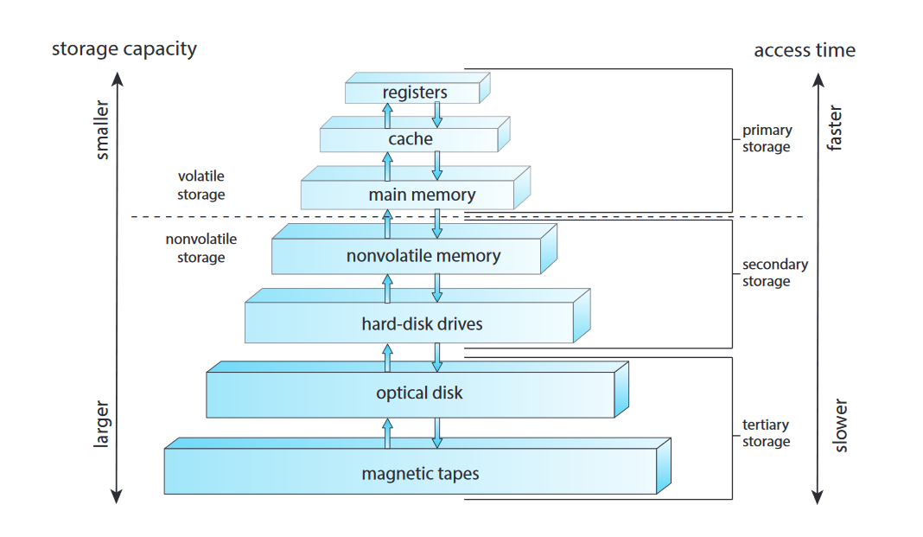
Storage Structure

Slide 16
Memory Units
Digital device : it stores everything in the form of digits.
What do you mean by storing++++++==➔ keeps the data in a place.
How to major?
[]----------space which is capable of storing 1 data either 0 0r 1 is called one bit
[]---------------------1 bit
[][][][] 4 bit --------------- 1 nibble
[][][][][][][][] 8 bit -----------1 Byte
1024 Byte--------------------1 KB
1024 KB-----------------------1 MB
1024 MB-----------------------1 GB
1024 GB-------------------------1 TB
1024TB --------------------------1 PG
1024PB------------------------------1HB

Slide 17
Computer-System Architecture
Single-Processor Systems
Multiprocessor Systems
Clustered Systems

Slide 18
Operating-System Operations
Process Management
Memory Management
File-System Management
Mass-Storage Management
Cache Management
I/O System Management
Security and Protection

Slide 19
Process Management
Process : A process is a program in execution. As a process executes, it changes state. The state of a process is defined in part by the current activity of that process. A process may be in one of the following states:
New. The process is being created.
• Running. Instructions are being executed.
• Waiting. The process is waiting for some event to occur (such as an I/O completion or reception of a signal).
• Ready. The process is waiting to be assigned to a processor.

Slide 20
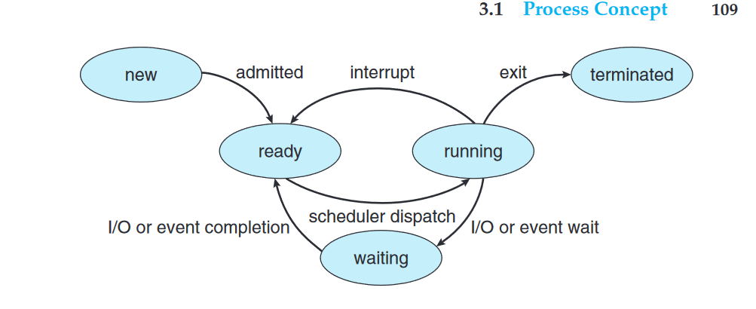
Process Management
Terminated. The process has finished execution.

Slide 21
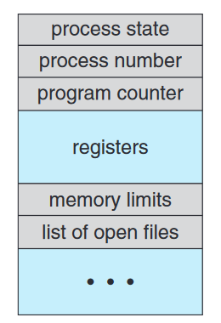
Process Control Block
Each process is represented in the operating system by a process control block (PCB)

Slide 22
Process Control Block
Process state : The state may be new, ready, running, waiting, halted, and so on.
• Program counter : The counter indicates the address of the next instruction to be executed for this process.
CPU registers : The registers vary in number and type, depending on the computer architecture. They include accumulators, index registers, stack pointers, and general-purpose registers, plus any condition-code information. Along with the program counter, this state information must be saved when an interrupt occurs, to allow the process to be continued correctly afterward when it is rescheduled to run

Slide 23
Process Control Block
CPU-scheduling information : This information includes a process priority, pointers to scheduling queues, and any other scheduling parameters.
• Memory-management information :This information may include such items as the value of the base and limit registers and the page tables, or the segment tables, depending on the memory system used by the operating
• Accounting information :This information includes the amount of CPU and real time used, time limits, account numbers, job or process numbers, and so on.
• I/O status information : This information includes the list of I/O devices allocated to the process, a list of open files, and so on.
PCB simply serves as the repository for all the data needed to start, or restart, a process, along with some accounting data.

Slide 24
Schedulers
Schedulers are specialized computer programmed (Part of Operating System) that manage process scheduling in a variety of ways. Their primary responsibility is to choose which jobs to submit into the system and which processes to run
There are three types of schedulers:
Long-Term : A job scheduler is another name for it. A long-term scheduler determines which programmers are accepted for processing into the system. It picks processes from the queue and then loads them into memory so they can be executed.

Slide 25
Schedulers
Short-Term : CPU scheduler is another name for it. Its major goal is to improve system performance according to the set of criteria defined. It refers to the transition from the process’s ready state to the running stage. The CPU scheduler happens to choose a process from those that are ready to run and then allocates the CPU to it.
Medium-Term : It includes medium-term scheduling. Swapping clears the memory of the processes. The degree of multiprogramming is reduced. The switched out processes are handled by the medium-term scheduler.

Slide 26
Process Scheduling
The objective of multiprogramming is to have some process running at all times so as to maximize CPU utilization.
The objective of time sharing is to switch a CPU core among processes so frequently that users can interact with each program while it is running.
To meet these objectives, the process scheduler selects an available process (possibly from a set of several available processes) for program execution on a core. Each CPU core can run one process at a time

Slide 27
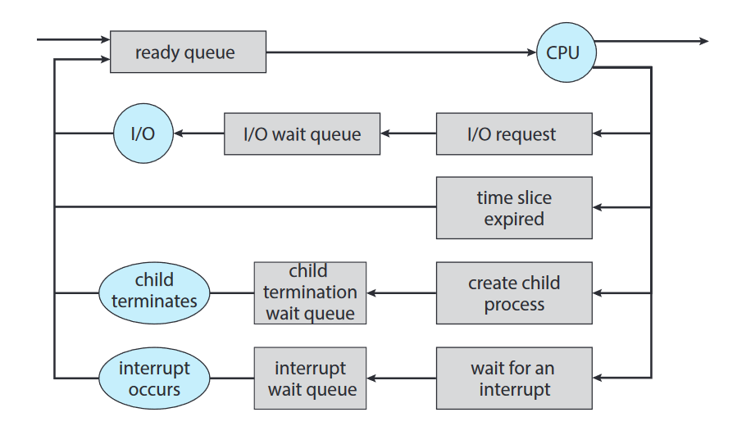
Process Scheduling Queues

Slide 28
Process Scheduling
The process could issue an I/O request and then be placed in an I/O wait queue.
• The process could create a new child process and then be placed in a wait queue while it awaits the child’s termination.
• The process could be removed forcibly from the core, as a result of an
interrupt or having its time slice expire, and be put back in the ready queue.

Slide 29
CPU Scheduling
CPU scheduling is the basis of multi programmed operating systems. By switching the CPU among processes, the operating system can make the computer more productive.
A process migrates among the ready queue and various wait queues throughout its lifetime.
The role of the CPU scheduler is to select from among the processes that are in the ready queue and allocate a CPU core to one of them.

Slide 30
Context Switch
Switching the CPU core to another process requires performing a state save of the current process and a state restore of a different process. This task is known as a context switch
When a context switch occurs, the kernel saves the context of the old process in its PCB and loads the saved context of the new process scheduled to run.

Slide 31
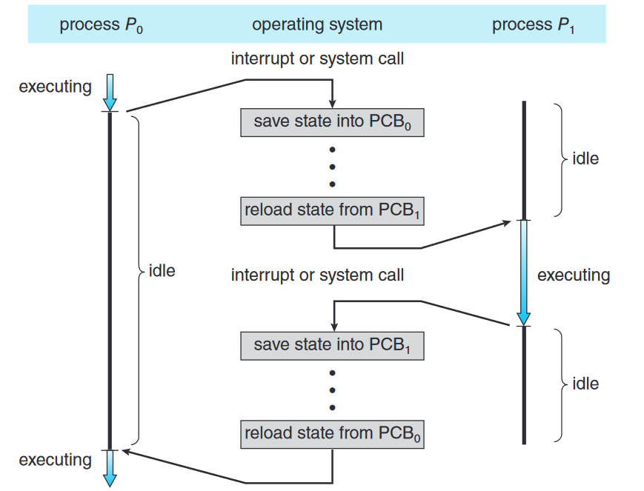
Context Switch

Slide 32
Threading
A thread is a basic unit of CPU utilization.
it comprises a thread ID , a program counter (PC ), a register set, and a stack.
It shares with other threads belonging to the same process its code section, data section, and other operating-system resources, such as open files and signals.
A traditional process has a single thread of control.
If a process has multiple threads of control, it can perform more than one task at a time.

Slide 33
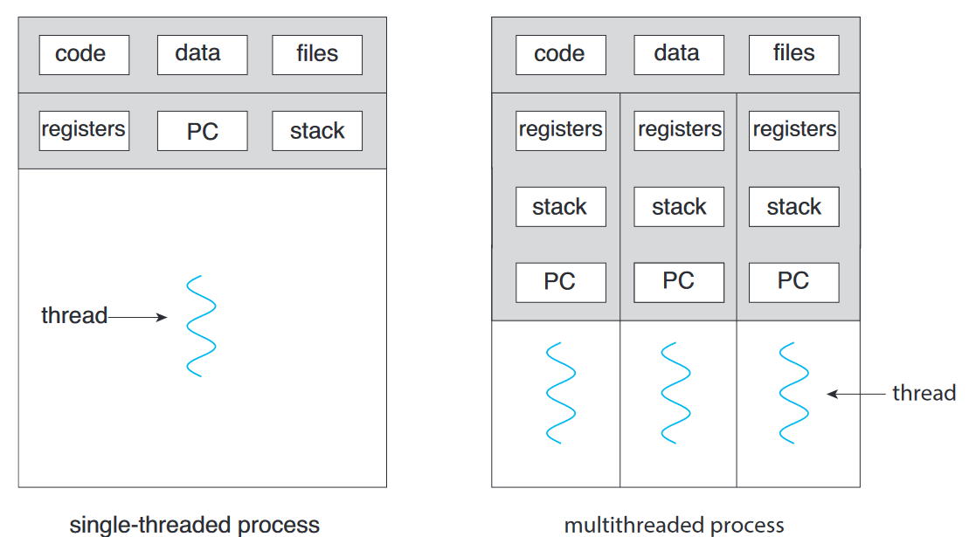
Threading

Slide 34
Benefits of Multithreading
Responsiveness.
Resource sharing.
Economy.

Slide 35
Types of Parallelism
Data parallelism : focuses on distributing subsets of the same data across multiple computing cores and performing the same operation on each core.
Task parallelism : Task parallelism involves distributing not data but tasks (threads) across multiple computing cores. Each thread is performing a unique operation. Different threads may be operating on the same data, or they may be operating on different data.

Slide 36
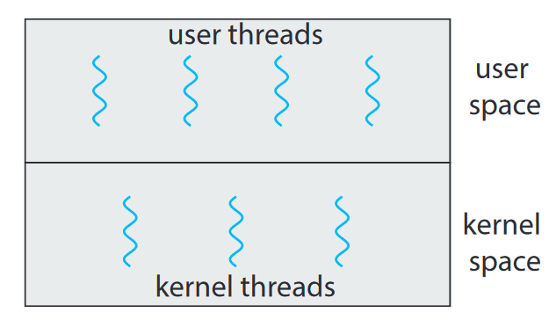
Types of Parallelism

Slide 37
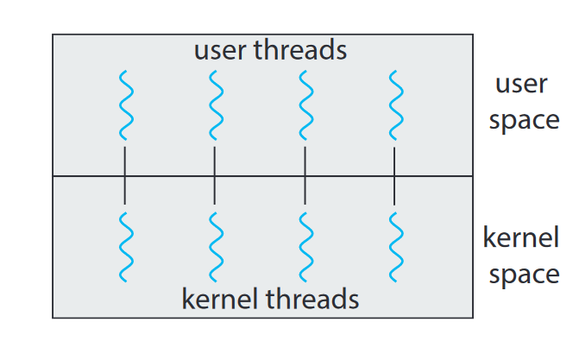
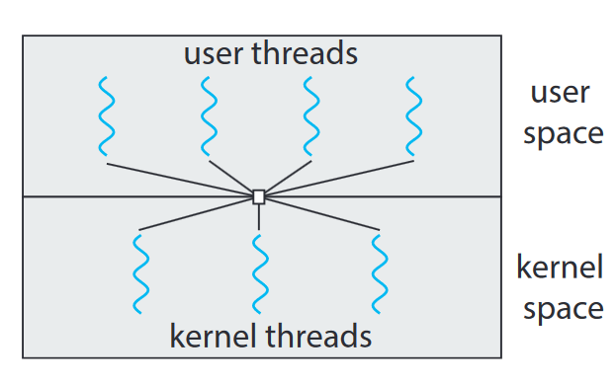
Multithreading Models
Many-to-One Model :
Many –to-Many Model:

Slide 38
Windows Threads
A Windows application runs as a separate process, and each process may contain one or more threads
Windows uses the one-to-one mapping where each user-level thread maps to an associated kernel thread.

Slide 39
General components of a thread
• A thread ID uniquely identifying the thread
• A register set representing the status of the processor
• A program counter
• A user stack, employed when the thread is running in user mode, and a kernel stack, employed when the thread is running in kernel mode
• A private storage area used by various run-time libraries and dynamic link libraries (DLLs)

Slide 40
The primary data structures of a thread
ETHREAD —executive thread block
• KTHREAD —kernel thread block
• TEB —thread environment block

Slide 41
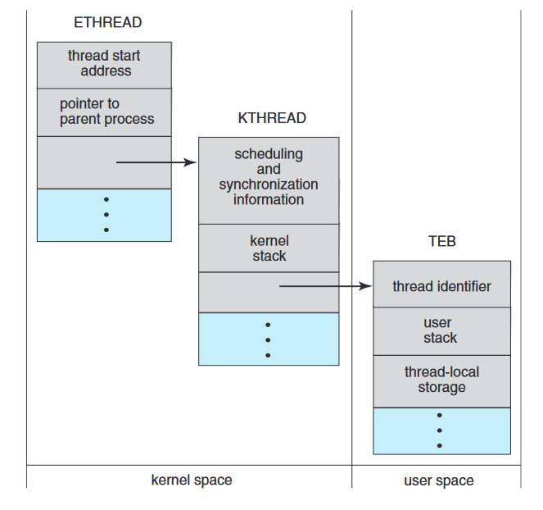

Slide 42
Memory Management
Main memory is a repository of quickly accessible data shared by the CPU and I/O devices.
The CPU reads instructions from main memory during the instruction-fetch cycle and both reads and writes data from main memory during the data-fetch cycle.
The main memory is generally the only large storage device that the CPU is able to address and access directly.
For a program to be executed, it must be mapped to absolute addresses and loaded into memory.
As the program executes, it accesses program instructions and data from memory by generating these absolute addresses.
Eventually, the program terminates, its memory space is declared available, and the next program can be loaded and executed.

Slide 43
Memory Management
The operating system is responsible for the following activities in connection with memory management:
Keeping track of which parts of memory are currently being used and which process is using them
Allocating and deallocating memory space as needed
Deciding which processes (or parts of processes) and data to move into and out of memory

Slide 44
Logical Address Space
We first need to make sure that each process has a separate memory space.
Separate per-process memory space protects the processes from each other and is fundamental to having multiple processes loaded in memory for concurrent execution.
To separate memory spaces, we need the ability to determine the range of legal addresses that the process may access and to ensure that the process can access only these legal addresses.
We can provide this protection by using two registers, usually a base register and a limit register.
The base register holds the smallest legal physical memory address; the limit register specifies the size of the range

Slide 45
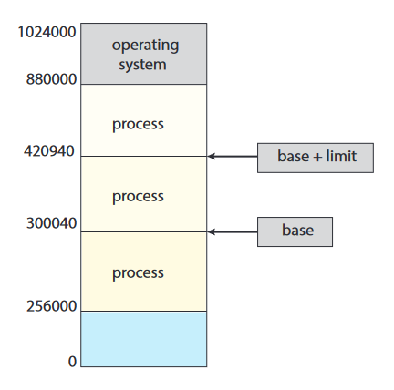
Logical Address Space Example
If the base register holds 300040 and the limit register is 120900, then the program can legally access all addresses from 300040 through 420939 (inclusive)

Slide 46
Protection
Protection of memory space is accomplished by having the CPU hardware compare every address generated in user mode with the registers.
Any attempt by a program executing in user mode to access operating-system memory or other users’ memory results in a trap to the operating system, which treats the attempt as a fatal error

Slide 47
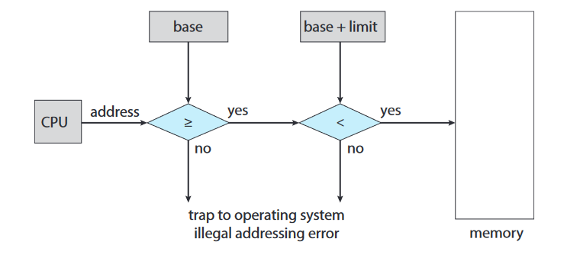
Protection

Slide 48
Address Binding
Compile time : If you know at compile time where the process will reside in memory, then absolute code can be generated.
For example :if you know that a user process will reside starting at location R, then the generated compiler code will start at that location and extend up from there. If, at some later time, the starting location changes, then it will be necessary to recompile this code.
Load time : If it is not known at compile time where the process will reside in memory, then the compiler must generate relocatable code. In this case, final binding is delayed until load time. If the starting address changes, we need only reload the user code to incorporate this changed value.
Execution time :If the process can be moved during its execution from one memory segment to another, then binding must be delayed until run time

Slide 49
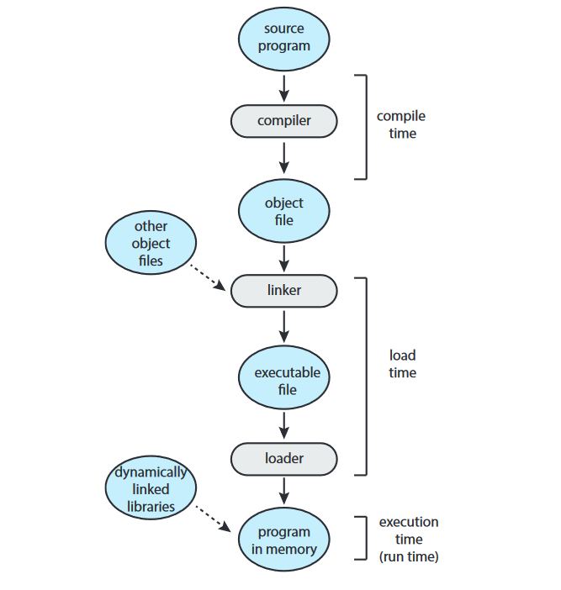
Address Binding

Slide 50
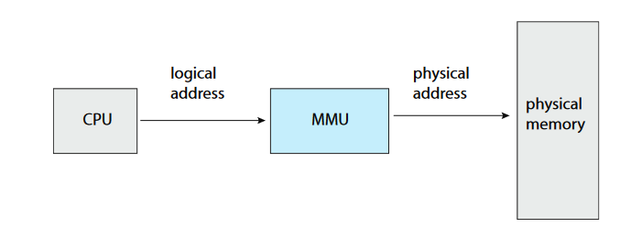
Logical and Physical Address
An address generated by the CPU is commonly referred to as a logical address, whereas an address seen by the memory unit—that is, the one loaded into the memory-address register of the memory—is commonly referred to as a physical address.

Slide 51
Logical and Physical Address
Binding addresses at either compile or load time generates identical logical and physical addresses.
The execution-time address-binding scheme results in differing logical and physical addresses. In this case, we usually refer to the logical address as a virtual address.
The set of all logical addresses generated by a program is a logical address space.
The set of all physical addresses corresponding to these logical addresses is a physical address space.
The run-time mapping from virtual to physical addresses is done by a hardware device called the memory-management unit (MMU)

Slide 52
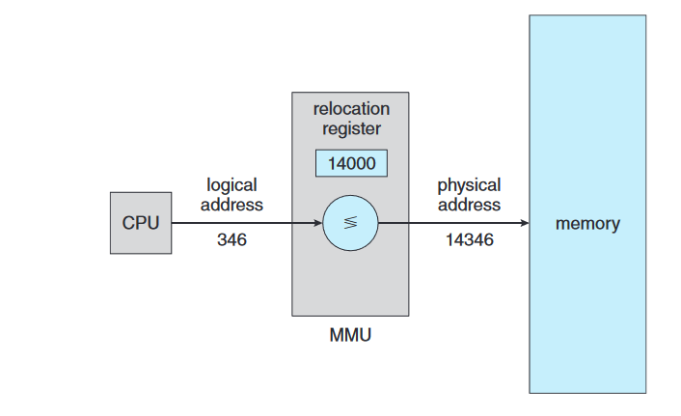
Logical and Physical Address-Mapping

Slide 53
Logical and Physical Address-Mapping
The base register is now called a relocation register. The value in the relocation register is added to every address generated by a user process at the time the address is sent to memory
For example, if the base is at 14000, then an attempt by the user to address location 0 is dynamically relocated to location 14000; an access to location 346 is mapped to location 14346

Slide 54
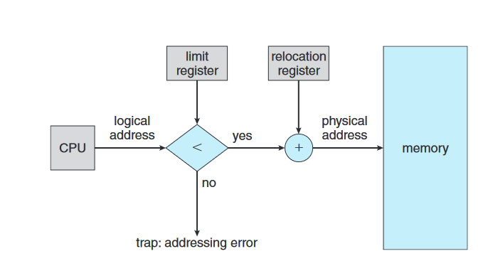
Logical and Physical Address-Mapping (Memory Protection)

Slide 55
Memory Allocation
One of the simplest methods of allocating memory is to assign processes to variably sized partitions in memory, where each partition may contain exactly one process.
In this variable partition scheme, the operating system keeps a table indicating which parts of memory are available and which are occupied.
Initially, all memory is available for user processes and is considered one large block of available memory, a hole.
In general the memory blocks available comprise a set of holes of various sizes scattered throughout memory.

Slide 56
Memory Allocation
When a process arrives and needs memory, the system searches the set for a hole that is large enough for this process.
If the hole is too large, it is split into two parts. One part is allocated to the arriving process; the other is returned to the set of holes.
When a process terminates, it releases its block of memory, which is then placed back in the set of holes.
If the new hole is adjacent to other holes, these adjacent holes are merged to form one larger hole.

Slide 57
Algorithm for Memory allocation
First-fit: Allocate the first hole that is big enough. Searching can start either at the beginning of the set of holes or at the location where the previous first-fit search ended. We can stop searching as soon as we find a free hole that is large enough.
Best-fit : Allocate the smallest hole that is big enough. We must search the entire list, unless the list is ordered by size. This strategy produces the smallest leftover hole.
Worst-fit : Allocate the largest hole. Again, we must search the entire list, unless it is sorted by size. This strategy produces the largest leftover hole, which may be more useful than the smaller leftover hole from a best-fit approach.

Slide 58
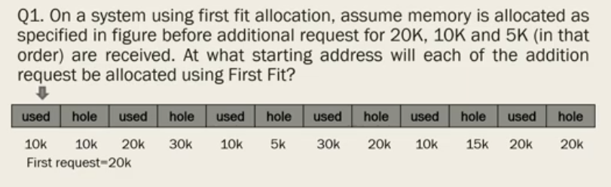
Example –First Fit

Slide 59
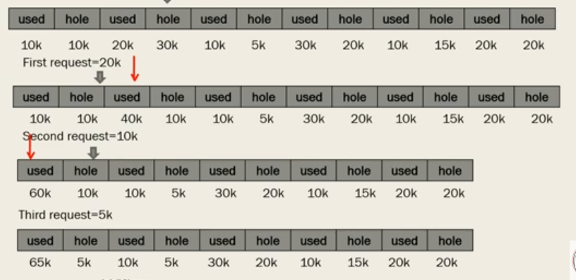
Solution (First Fit)

Slide 60
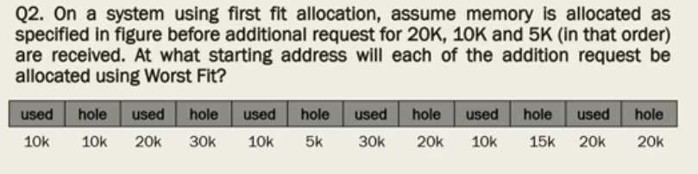
Example – Worst Fit

Slide 61
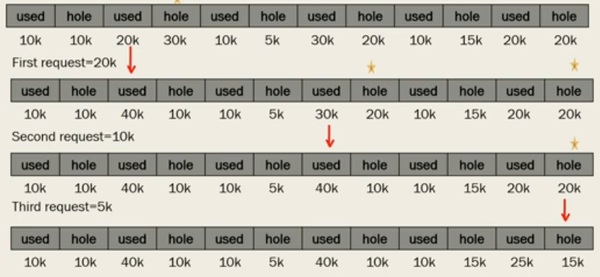
Solution- Worst Fit

Slide 62
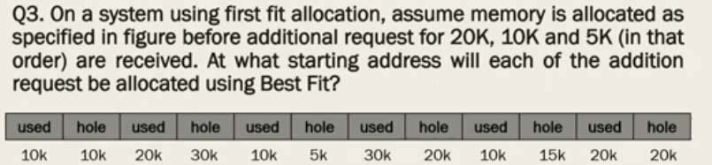
Example – Best Fit

Slide 63
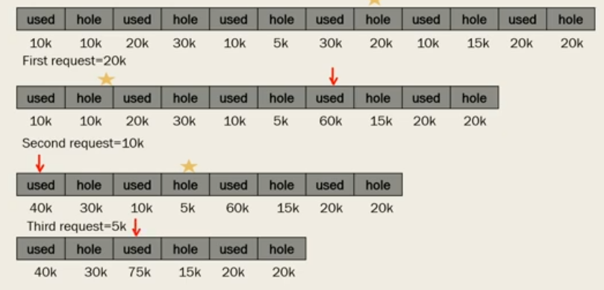
Solution- Best Fit

Slide 64
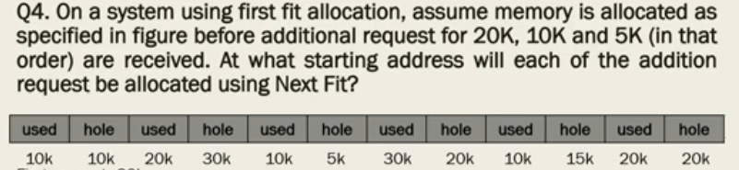
Example – Next Fit

Slide 65
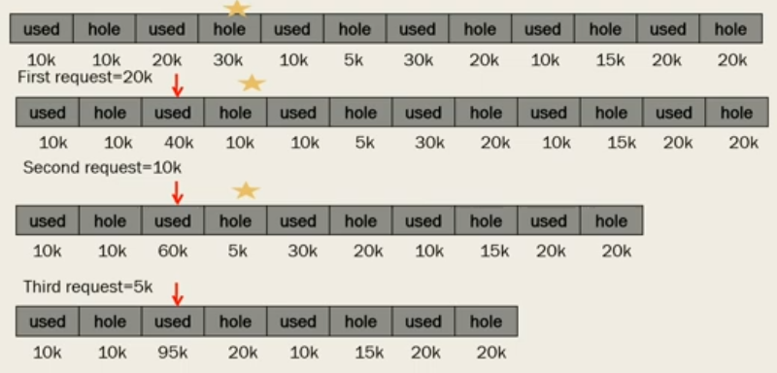
Solution- Next Fit

Slide 66
Fragmentation
Fragmentation refers to an unwanted problem that occurs in the OS in which a process is unloaded and loaded from memory, and the free memory space gets fragmented.
The processes can not be assigned to the memory blocks because of their small size. Thus the memory blocks always stay unused.
The implications of the process of fragmentation depend entirely on the specific allocation of storage space schemes in the operation along with the particular fragmentation types. In some instances, fragmentation leads to some unused storage capacity.

Slide 67
Types of Fragmentation
External Fragmentation : The total memory space is sufficient to satisfy a given request or reside any process in it. Yet it isn’t contiguous; thus, it can’t be used. It is what leads to external fragmentation, and it can be reduced using compaction or by shuffling the memory contents in order to place together all the free memory into a single large block. In order to make the compaction feasible, relocation must be dynamic.
Internal Fragmentation :Whenever a memory block gets allocated with a process, and in case the process happens to be smaller than the total amount of requested memory, a free space is ultimately created in this memory block. And due to this, the memory block’s free space is unused. This is what causes internal fragmentation.

Slide 68
Paging
Paging is a storage mechanism used in OS to retrieve processes from secondary storage to the main memory as pages. The primary concept behind paging is to break each process into individual pages. Thus the primary memory would also be separated into frames.
One page of the process must be saved in one of the given memory frames. These pages can be stored in various memory locations, but finding contiguous frames/holes is always the main goal. Process pages are usually only brought into the main memory when they are needed; else, they are stored in the secondary storage.
The frame sizes may vary depending on the OS. Each frame must be of the same size. Since the pages present in paging are mapped on to the frames, the page size should be similar to the frame size.

Slide 69
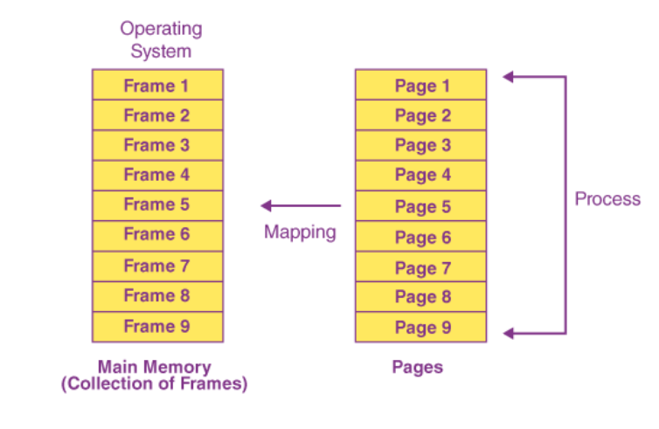
Page and page frame

Slide 70
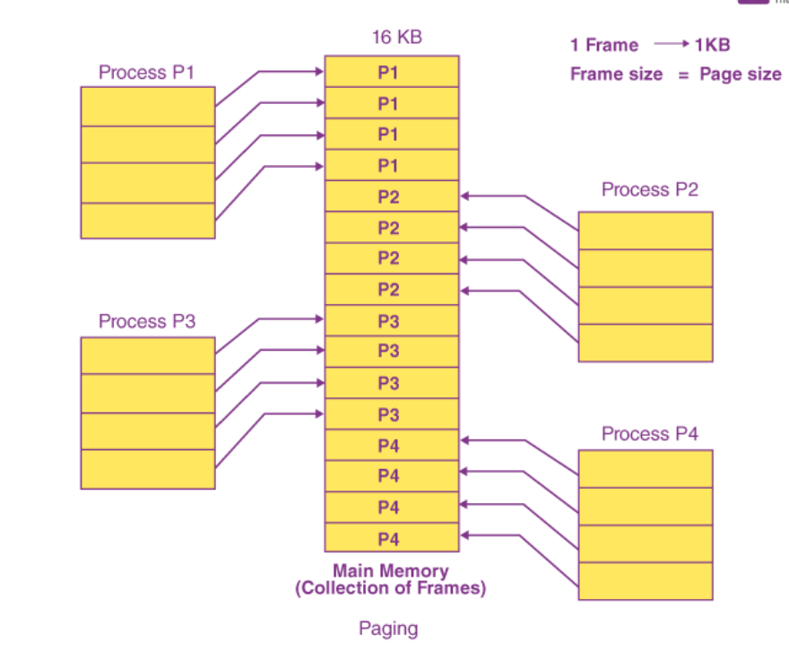
Paging Example

Slide 71
Assuming that the main memory is 16 KB and the frame size is 1 KB, the main memory will be partitioned into a collection of 16 1 KB frames. P1, P2, P3, and P4 are the four processes in the system, each of which is 4 KB in size. Each process is separated into 1 KB pages, allowing one page to be saved in a single frame.
Consider the case when P2 and P4 are shifted to the waiting state after a period of time. Eight frames are now empty, allowing other pages to be loaded in their stead. Inside the ready queue is the process P5, which is 8 KB (8 pages) in size.
Given that we have 8 noncontiguous frames accessible in memory, paging allows us to store the process in many locations. As a result, we can load the process P5 page instead of P2 and P4.

Slide 72
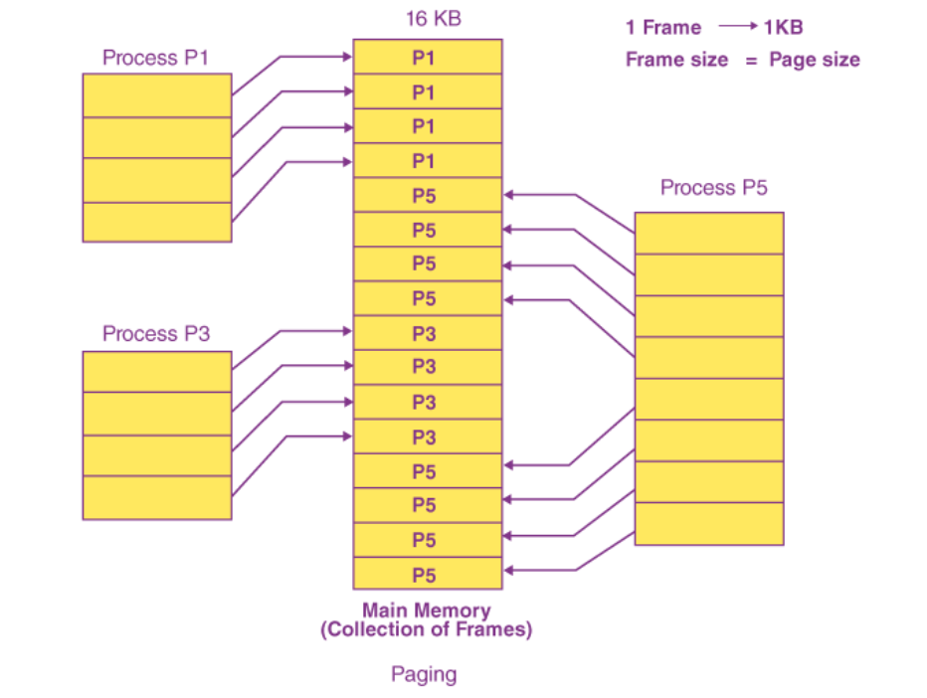

Slide 73
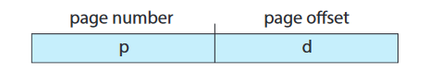
When a process is to be executed, its pages are loaded into any available memory frames from their source (a file system or the backing store).
The backing store is divided into fixed-sized blocks that are the same size as the memory frames or clusters of multiple frames.
The logical address space is now totally separate from the physical address space
Every address generated by the CPU is divided into two parts: a page number (p) and a page offset (d):

Slide 74
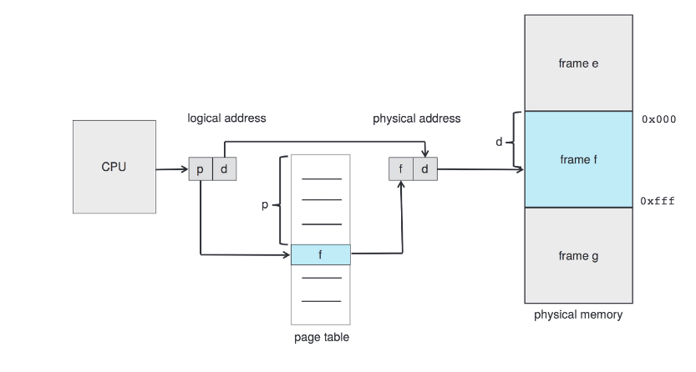
Paging Hardware

Slide 75
The page number is used as an index into a per-process page table.
The page table contains the base address of each frame in physical memory, and the offset is the location in the frame being referenced.
Thus, the base address of the frame is combined with the page offset to define the physical memory address.

Slide 76
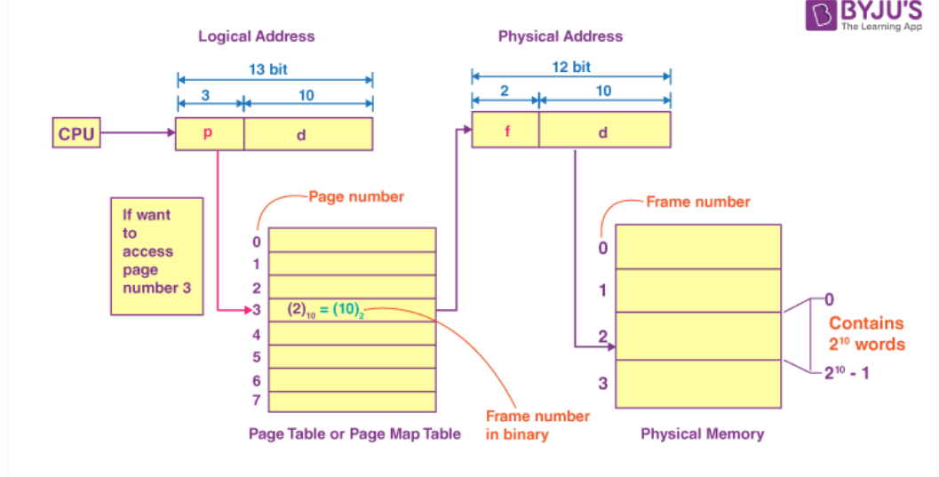
Mapping of Logical Address to physical address

Slide 77
Address by CPU
The address generated by the CPU is divided into the following:
Page offset(d): It refers to the number of bits necessary to represent a certain word on a page, page size in Logical Address Space, or page word number or page offset.
Page number(p): It is the number of bits needed to represent the pages in the Logical Address Space or the page number.

Slide 78
Physical Address
Frame offset(d): It refers to the number of bits necessary to represent a certain word in a frame, or the Physical Address Space frame size, the word number of a frame, or the frame offset.
Frame number(f): It’s the number of bits needed to indicate a frame of the Physical Address Space or a frame number.

Slide 79
Translation Look-Aside Buffer
We can employ TLB (translation look-aside buffer), a particular, tiny, fast look-up hardware cache if the page table has a significant number of entries.
The TLB is a high-speed, associative memory.
LB entries are made up of two parts: a value and a tag.
When this memory is accessed, an item is compared to all tags at the same time.
If the object is located, the value associated with it is returned.

Slide 80
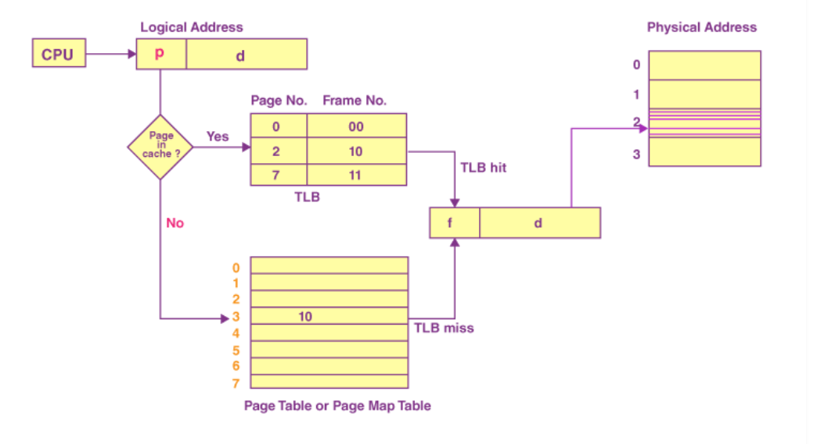

Slide 81
Swapping
A process, or a portion of a process, can be swapped temporarily out of memory to a backing store and then brought back into memory for continued execution.
Swapping makes it possible for the total physical address space of all processes to exceed the real physical memory of the system, thus increasing the degree of multiprogramming in a system.

Slide 82
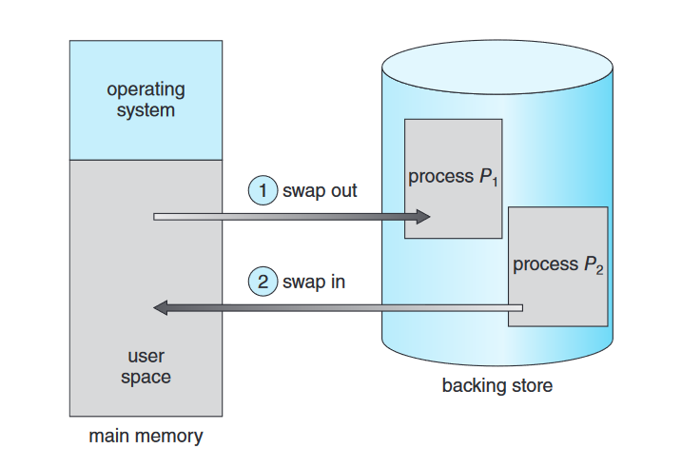
Swapping

Slide 83
Swapping
Standard Swapping :
Standard swapping involves moving entire processes between main memory and a backing store. The backing store is commonly fast secondary storage.
It must be large enough to accommodate whatever parts of processes need to be stored and retrieved, and it must provide direct access to these memory images.
When a process or part is swapped to the backing store, the data structures associated with the process must be written to the backing store.
For a multithreaded process, all per-thread data structures must be swapped as well. The operating system must also maintain metadata for processes that have been swapped out, so they can be restored when they are swapped back in to memory.
The advantage of standard swapping is that it allows physical memory to be oversubscribed, so that the system can accommodate more processes than there is actual physical memory to store them. Idle or mostly idle processes are good candidates for swapping; any memory that has been allocated to these inactive processes can then be dedicated to active processes.
If an inactive process that has been swapped out becomes active once again, it must then be swapped back in

Slide 84
Swapping
Swapping with Paging
Most systems, including Linux and Windows, now use a variation of swapping in which pages of a process—rather than an entire process—can be swapped.
This strategy still allows physical memory to be oversubscribed, as presumably only a small number of pages will be involved in swapping.
In fact, the term swapping now generally refers to standard swapping, and paging refers to swapping with paging.
A page out operation moves a page from memory to the backing store.
The reverse process is known as a page in.

Slide 85
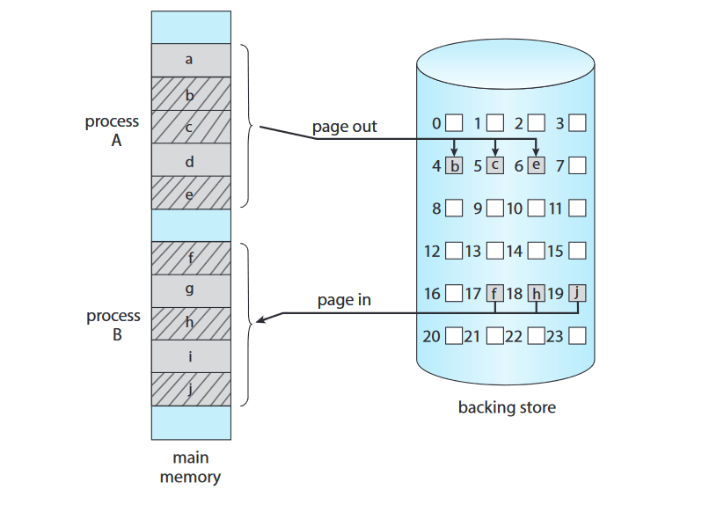

Slide 86
Virtual Memory
Virtual memory is a technique that allows the execution of processes that are not completely in memory.
One major advantage of this scheme is that programs can be larger than physical memory. Further, virtual memory abstracts main memory into an extremely large, uniform array of storage, separating logical memory as viewed by the programmer from physical memory.
This technique frees programmers from the concerns of memory-storage limitations.
Virtual memory also allows processes to share files and libraries, and to implement shared memory. In addition, it provides an efficient mechanism for process creation.

Slide 87
Virtual Memory
Virtual memory involves the separation of logical memory as perceived by developers from physical memory.
This separation allows an extremely large virtual memory to be provided for programmers when only a smaller physical memory is available
The virtual address space of a process refers to the logical (or virtual) view of how a process is stored in memory.
In addition to separating logical memory from physical memory, virtual memory allows files and memory to be shared by two or more processes through page sharing

Slide 88
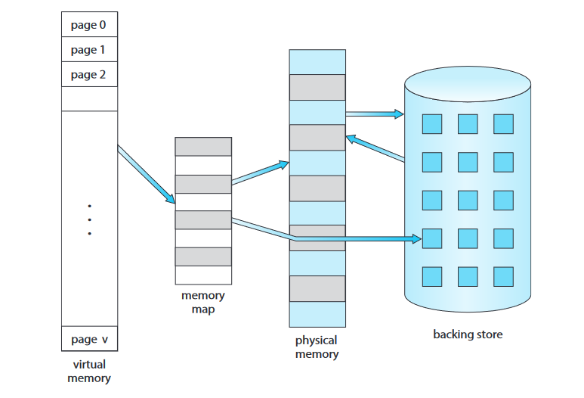

Slide 89
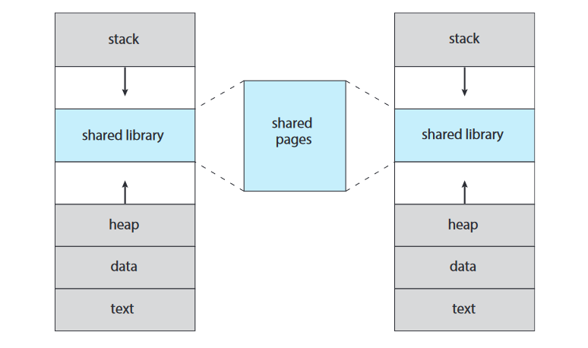
Shared library using virtual memory

Slide 90
Demand Paging
Loading the entire program into memory results in loading the executable code for all options, regardless of whether or not an option is ultimately selected by the user.
An alternative strategy is to load pages only as they are needed. This technique is known as demand paging and is commonly used in virtual memory systems.
With demand-paged virtual memory, pages are loaded only when they are demanded during program execution.
Pages that are never accessed are thus never loaded into physical memory.

Slide 91
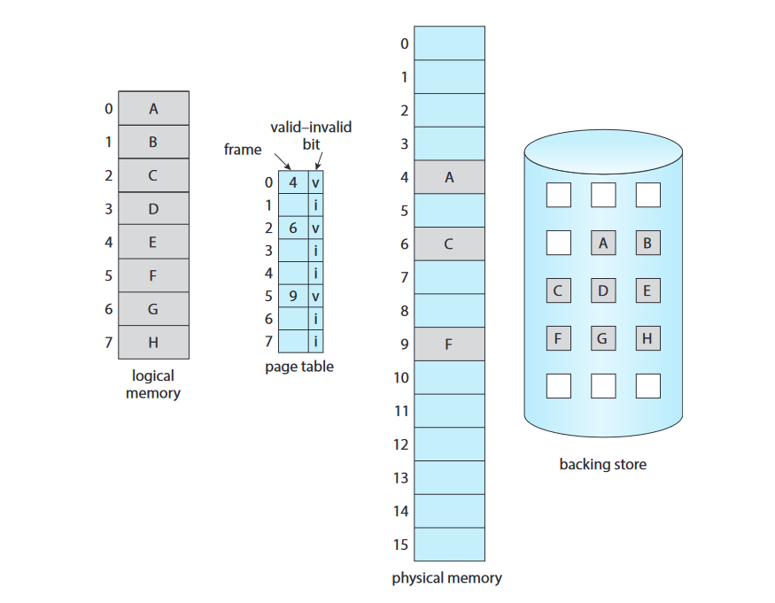

Slide 92
Page fault
what happens if the process tries to access a page that was not brought into memory? Access to a page marked invalid causes a page fault.
The paging hardware, in translating the address through the page table, will notice that the invalid bit is set, causing a trap to the operating system.
This trap is the result of the operating system’s failure to bring the desired page into memory.

Slide 93
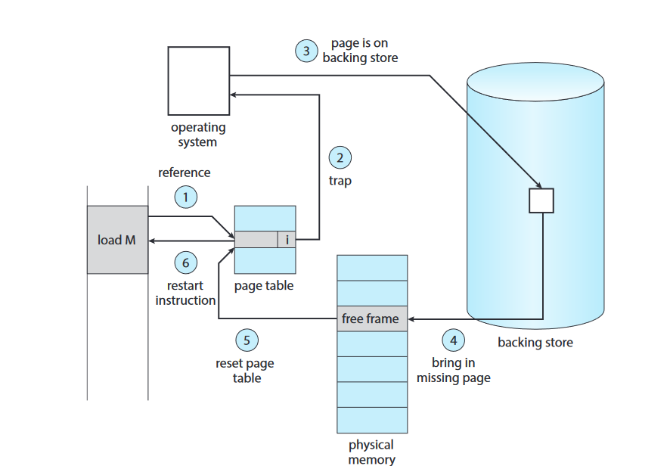
Handling Page fault

Slide 94
Handling Page fault
1. We check an internal table (usually kept with the process control block) for this process to determine whether the reference was a valid or an invalid memory access.
2. If the reference was invalid, we terminate the process. If it was valid but we have not yet brought in that page, we now page it in.
3. We find a free frame (by taking one from the free-frame list, for example).
4. We schedule a secondary storage operation to read the desired page into
the newly allocated frame.
5. When the storage read is complete, we modify the internal table kept with
the process and the page table to indicate that the page is now in memory.
6. We restart the instruction that was interrupted by the trap. The process
can now access the page as though it had always been in memory.

Slide 95
Handling Page fault
1. Trap to the operating system.
2. Save the registers and process state.
3. Determine that the interrupt was a page fault.
4. Check that the page reference was legal, and determine the location of the page in secondary storage.
5. Issue a read from the storage to a free frame:
a. Wait in a queue until the read request is serviced.
b. Wait for the device seek and/or latency time.
c. Begin the transfer of the page to a free frame.
6. While waiting, allocate the CPU core to some other process.
7. Receive an interrupt from the storage I/O subsystem (I/O completed).
8. Save the registers and process state for the other process (if step 6 is executed).
9. Determine that the interrupt was from the secondary storage device.
10. Correct the page table and other tables to show that the desired page is now in memory.
11. Wait for the CPU core to be allocated to this process again
12.Restore the registers, process state, and new page table, and then resume the interrupted instruction.

Slide 96
Page Replacement
If no frame is free, we find one that is not currently being used and free it.
We can free a frame by writing its contents to swap space and changing the page table (and all other tables) to indicate that the page is no longer in memory .
We can now use the freed frame to hold the page for which the process faulted.

Slide 97
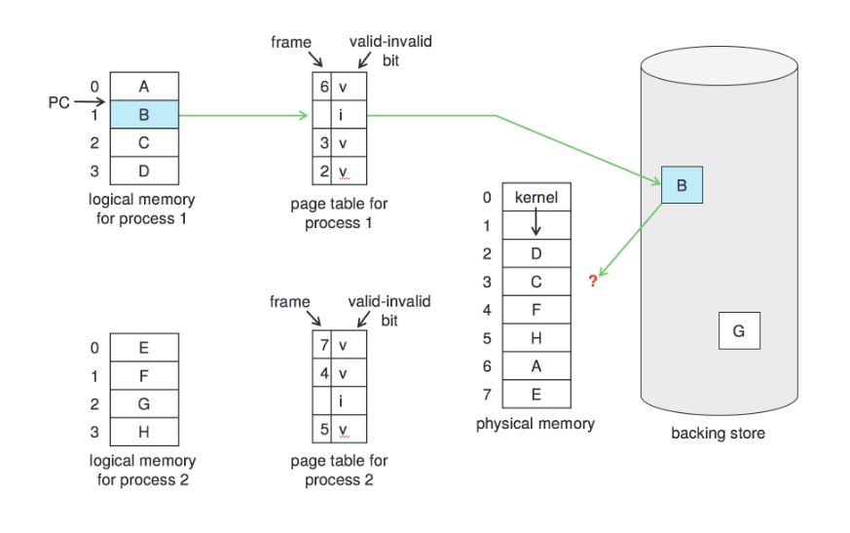
Page Replacement

Slide 98
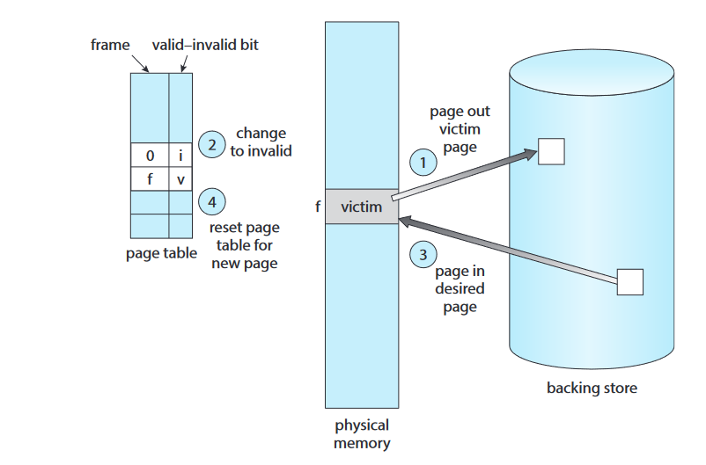
Page Replacement

Slide 99
Page Replacement
1. Find the location of the desired page on secondary storage.
2. Find a free frame:
a. If there is a free frame, use it.
b. If there is no free frame, use a page-replacement algorithm to select
a victim frame.
c. Write the victim frame to secondary storage (if necessary); change
the page and frame tables accordingly.
3. Read the desired page into the newly freed frame; change the page and
frame tables.
4. Continue the process from where the page fault occurred.

Slide 100
Page Replacement Algorithm (FIFO)
The simplest page-replacement algorithm is a first-in, first-out ( FIFO) algorithm.
A FIFO replacement algorithm associates with each page the time
when that page was brought into memory. When a page must be replaced, the oldest page is chosen.
The FIFO page-replacement algorithm is easy to understand and program.

Slide 101
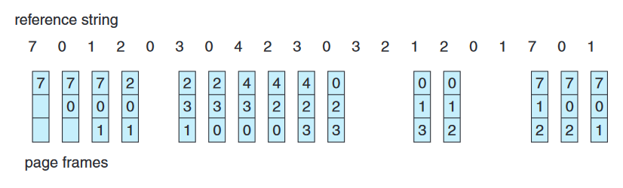
Page Replacement Algorithm (FIFO) (Hit Ratio and Miss ratio)

Slide 102
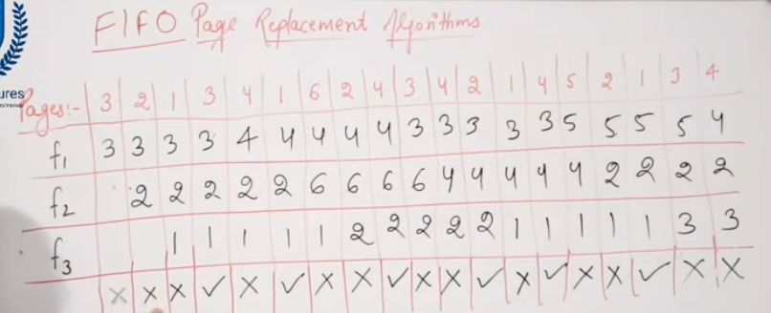

Slide 103
Belady’s anomaly
For some page-replacement algorithms, the page-fault rate may increase as the number of allocated frames increases
String:
1, 2, 3, 4, 1, 2, 5, 1, 2, 3, 4, 5
Notice that the number of faults for four frames (ten) is greater than the number of faults for three frames (nine)!

Slide 104
Optimal Page Replacement
One result of the discovery of Belady’s anomaly was the search for an optimal page-replacement algorithm—the algorithm that has the lowest page-fault rate of all algorithms and will never suffer from Belady’s anomaly.
Such an algorithm does exist and has been called OPT or MIN. It is simply this:
Replace the page that will not be used for the longest period of time.
Use of this page-replacement algorithm guarantees the lowest possible pagefault rate for a fixed number of frames.
Unfortunately, the optimal page-replacement algorithm is difficult to implement, because it requires future knowledge of the reference string.

Slide 105
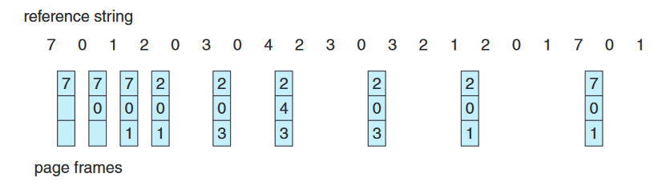
Optimal Page Replacement (Hit Ratio and Miss ratio)

Slide 106
LRU Page Replacement
If we use the recent past as an approximation of the near future, then we can replace the page that has not been used for the longest period of time. This approach is the least recently used ( LRU) algorithm.
LRU replacement associates with each page the time of that page’s last use.
When a page must be replaced, LRU chooses the page that has not been used for the longest period of time.
We can think of this strategy as the optimal page-replacement algorithm looking backward in time, rather than forward.

Slide 107
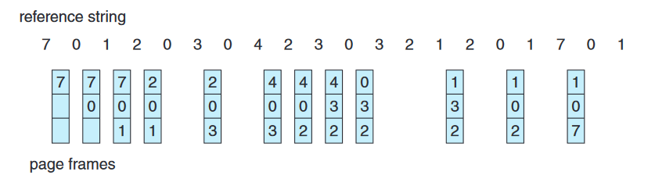
LRU Page Replacement

Slide 108
Counting-Based Page Replacement
We can keep a counter of the number of references that have been made to each page and develop the following two schemes.
LFU(least frequently used) :
The least frequently used (LFU) page-replacement algorithm requires that the page with the smallest count be replaced. The reason for this selection is that an actively used page should have a large reference count.
A problem arises, however, when a page is used heavily during the initial phase of a process but then is never used again. Since it was used heavily, it has a large count and remains in memory even though it is no longer needed.
One solution is to shift the counts right by 1 bit at regular intervals, forming an exponentially decaying average usage count.

Slide 109
Counting-Based Page Replacement
Most Frequently Used(MFU) :
The most frequently used (MFU) page-replacement algorithm is based on the argument that the page with the smallest count was probably just brought in and has yet to be used.

Slide 110
Exercise-1
Apply the (1) FIFO, (2) LRU, and (3) optimal (OPT ) replacement algorithms for the following page-reference strings:
• 2, 6, 9, 2, 4, 2, 1, 7, 3, 0, 5, 2, 1, 2, 9, 5, 7, 3, 8, 5
• 0, 6, 3, 0, 2, 6, 3, 5, 2, 4, 1, 3, 0, 6, 1, 4, 2, 3, 5, 7
• 3, 1, 4, 2, 5, 4, 1, 3, 5, 2, 0, 1, 1, 0, 2, 3, 4, 5, 0, 1
• 4, 2, 1, 7, 9, 8, 3, 5, 2, 6, 8, 1, 0, 7, 2, 4, 1, 3, 5, 8
• 0, 1, 2, 3, 4, 4, 3, 2, 1, 0, 0, 1, 2, 3, 4, 4, 3, 2, 1, 0
Indicate the number of page faults for each algorithm assuming
demand paging with three frames.

Slide 111
Exercise-2
Consider the following page reference string:
7, 2, 3, 1, 2, 5, 3, 4, 6, 7, 7, 1, 0, 5, 4, 6, 2, 3, 0 , 1.
Assuming demand paging with three frames, how many page faults
would occur for the following replacement algorithms?
• LRU replacement
• FIFO replacement
• Optimal replacement

Slide 112
Allocation of frame
We can require that the operating system allocate all its buffer and table space from the free-frame list.
When this space is not in use by the operating system, it can be used to support user paging.
We can try to keep three free frames reserved on the free-frame list at all times. Thus, when a page fault occurs, there is a free frame available to page into.
While the page swap is taking place, a replacement can be selected, which is then written to the storage device as the user process continues to execute.

Slide 113
Allocation Algorithm
Equal Allocation :The easiest way to split m frames among n processes is to give everyone an equal share, m/n frames (ignoring frames needed by the operating system for the moment). For instance, if there are 93 frames and 5 processes, each process will get 18 frames. The 3 leftover frames can be used as a free-frame buffer pool.
Proportional allocation : we allocate available memory to each process according to its size.

Slide 114
Thrashing
Consider what occurs if a process does not have “enough” frames—that is, it does not have the minimum number of frames it needs to support pages in the working set.
The process will quickly page-fault. At this point, it must replace some page.
However, since all its pages are in active use, it must replace a page that will be needed again right away. Consequently, it quickly faults again, and again, and again, replacing pages that it must bring back in immediately.
This high paging activity is called thrashing.
A process is thrashing if it is spending more time paging than executing.
Thrashing results in severe performance problems

Slide 115
Cause of Thrashing
The operating system monitors CPU utilization.
If CPU utilization is too low, we increase the degree of multiprogramming by introducing a new process to the system.
A global page-replacement algorithm is used it replaces pages without regard to the process to which they belong. Now suppose that a process enters a new phase in its execution and needs more frames.
It starts faulting and taking frames away from other processes. These processes need those pages, however, and so they also fault, taking frames from other processes.
These faulting processes must use the paging device to swap pages in and out.
As they queue up for the paging device, the ready queue empties. As processes wait for the paging device, CPU utilization decreases.

Slide 116
Cause of Thrashing
The CPU scheduler sees the decreasing CPU utilization and increases the degree of multiprogramming as a result.
The new process tries to get started by taking frames from running processes, causing more page faults and a longer queue for the paging device.
As a result, CPU utilization drops even further, and the CPU scheduler tries to increase the degree of multiprogramming even more.
Thrashing has occurred, and system throughput plunges.

Slide 117
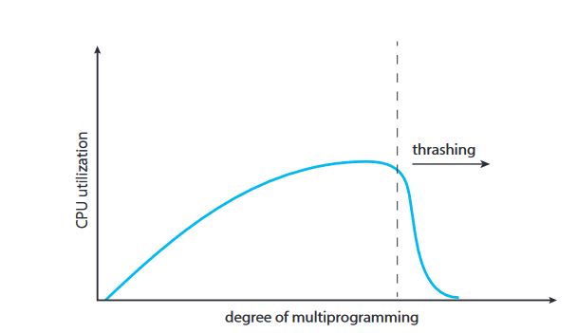
Cause of Thrashing

Slide 118
Cause of Thrashing
The page-fault rate increases tremendously. As a result, the effective memory-access time increases. No work is getting done, because the processes are spending all their time paging.
We can limit the effects of thrashing by using a local replacement algorithm (or priority replacement algorithm)
local replacement requires that each process select from only its own set of allocated frames.
If one process starts thrashing, it cannot steal frames from another process and cause the latter to thrash as well.

Slide 119
Prevention of thrashing
locality model :
The locality model states that, as a process executes, it moves from locality to locality.
A locality is a set of pages that are actively used together.
A running program is generally composed of several different localities, which may overlap.
When a function is called, it defines a new locality. In this locality, memory references are made to the instructions of the function call, its local variables, and a subset of the global variables. When we exit the function, the process leaves this locality, since the local variables and instructions of the function are no longer in active use

Slide 120


Slide 121
Locality Model
At time (a), the locality is the set of pages {18, 19, 20, 21, 22, 23, 24, 29, 30, 33}.
At time (b), the locality changes to {18, 19, 20, 24, 25, 26, 27, 28, 29, 31, 32, 33}.
Notice the overlap, as some pages (for example, 18, 19, and 20) are part of both localities
localities are defined by the program structure and its data structures. The locality model states that all programs will exhibit this basic memory reference structure.

Slide 122
Working-Set Model
The working-set model is based on the assumption of locality. This model uses a parameter, Δ, to define the working-set window.
The idea is to examine the most recent Δ page references. The set of pages in the most recent Δ page references is the working set . If a page is in active use, it will be in the working set. If it is no longer being used, it will drop from the working set Δ time units after its last reference.
Thus, the working set is an approximation of the program’s locality.

Slide 123

Working-Set Model

Slide 124
Working-Set Model
If Δ = 10 memory references, then the working set at time t1 is {1, 2, 5,6, 7}. By time t2 , the working set has changed to {3, 4}
The accuracy of the working set depends on the selection of Δ. If Δ is too small, it will not encompass the entire locality; if Δ is too large, it may overlap several localities. In the extreme, if Δ is infinite, the working set is the set of pages touched during the process execution.
The most important property of the working set, then, is its size.
If we compute the working-set size, WSSi, for each process in the system, we can then consider that
D = ∑ WSS i,
where D is the total demand for frames.

Slide 125
Working-Set Model
Each process is actively using the pages in its working set. Thus, process i needs WSSi frames.
If the total demand is greater than the total number of available frames (D > m), thrashing will occur, because some processes will not have enough frames.
Once Δ has been selected, use of the working-set model is simple. The operating system monitors the working set of each process and allocates to that working set enough frames to provide it with its working-set size.
If there are enough extra frames, another process can be initiated. If the sum of the working-set sizes increases, exceeding the total number of available frames, the operating system selects a process to suspend.
The process’s pages are written out (swapped), and its frames are reallocated to other processes. The suspended process can be restarted later.

Slide 126
Page-Fault Frequency
We can establish upper and lower bounds on the desired page-fault rate.
If the actual page-fault rate exceeds the upper limit, we allocate the process another frame.
If the page-fault rate falls below the lower limit, we remove a frame from the process. Thus, we can directly measure and control the page fault rate to prevent thrashing.
If the page-fault rate increases and no free frames are available, we must select some process and swap it out to backing store.
The freed frames are then distributed to processes with high page-fault rates.

Slide 127


Slide 128

Mass-Storage NVM(Non -Volatile Memory)

Slide 129
Hard Disk Drives
Conceptually, HDD s are relatively simple. Each disk platter has a flat circular shape, like a CD .
Common platter diameters range from 1.8 to 3.5 inches.
The two surfaces of a platter are covered with a magnetic material.
We store information by recording it magnetically on the platters, and we read information by detecting the magnetic pattern on the platters.
A read–write head “flies” just above each surface of every platter.
The heads are attached to a disk arm that moves all the heads as a unit.
The surface of a platter is logically divided into circular tracks, which are subdivided into sectors.
The set of tracks at a given arm position make up a cylinder.

Slide 130
Hard Disk Drives
There may be thousands of concentric cylinders in a disk drive, and each track may contain hundreds of sectors.
Each sector has a fixed size and is the smallest unit of transfer. The sector size was commonly 512 bytes until around 2010.
The storage capacity of common disk drives is measured in gigabytes and terabytes.
A disk drive motor spins it at high speed. Most drives rotate 60 to 250 times per second, specified in terms of rotations per minute (RPM).
Common drives spin at 5,400, 7,200, 10,000, and 15,000 RPM.
Some drives power down when not in use and spin up upon receiving an I/O request.
Rotation speed relates to transfer rates.

Slide 131
Hard Disk Drives
The transfer rate is the rate at which data flow between the drive and the computer.
The positioning time, or random-access time, consists of two parts:
Seek Time :The time necessary to move the disk arm to the desired cylinder.
Rotational latency : The time necessary for the desired sector to rotate to the disk head.
The disk head flies on an extremely thin cushion (measured in microns) of air or another gas, such as helium, and there is a danger that the head will make contact with the disk surface. Although the disk platters are coated with a thin protective layer, the head will sometimes damage the magnetic surface.
This accident is called a head crash. A head crash normally cannot be repaired.

Slide 132
Solid-state disk (SSD)
Flash-memory-based NVM is frequently used in a disk-drive-like container
NVM devices can be more reliable than HDD s because they have no moving parts and can be faster because they have no seek time or rotational latency, they consume less power.
On the negative side, they are more expensive per megabyte than traditional hard disks and have less capacity than the larger hard disks. Over time, however, the capacity of NVM devices has increased faster than HDD capacity, and their price has dropped more quickly, so their use is increasing dramatically.
In fact, SSD s and similar devices are now used in some laptop computers to make them smaller, faster, and more energy-efficient

Slide 133

Solid-state disk (SSD)

Slide 134
Secondary Storage Connection Methods
A secondary storage device is attached to a computer by the system bus or an I/O bus.
Several kinds of buses are available :
Advanced technology attachment (ATA)
Serial ATA (SATA),
eSATA
Serial attached SCSI (SAS)
uniersal serial bus (USB)
fibre channel (FC).

Slide 135
Data Transfer
The data transfers on a bus are carried out by special electronic processors called controllers (or host-bus adapters (HBA)).
The host controller is the controller at the computer end of the bus. A device controller is built into each storage device.
To perform a mass storage I/O operation, the computer places a command into the host controller, typically using memory-mapped I/O ports.
The host controller then sends the command via messages to the device controller, and the controller operates the drive hardware to carry out the command.
Device controllers usually have a built-in cache. Data transfer at the drive happens between the cache and the storage media, and data transfer to the host, at fast electronic speeds, occurs between the cache host DRAM via DMA

Slide 136
HDD Scheduling
Whenever a process needs I/O to or from the drive, it issues a system call to the operating system.
The request specifies several pieces of information:
Whether this operation is input or output
The open file handle indicating the file to operate on
What the memory address for the transfer is
The amount of data to transfer

Slide 137
FCFS Scheduling
The simplest form of disk scheduling is, of course, the first-come, first-served (FCFS) algorithm (or FIFO).
This algorithm is intrinsically fair, but it generally does not provide the fastest service.
Consider, for example, a disk queue with requests for I/O to blocks on cylinders
98, 183, 37, 122, 14, 124, 65, 67,
In that order. If the disk head is initially at cylinder 53, it will first move from 53 to 98, then to 183, 37, 122, 14, 124, 65, and finally to 67, for a total head movement of 640 cylinders.

Slide 138

FCFS Scheduling

Slide 139

SCAN Scheduling

Slide 140

C-SCAN Scheduling

Slide 141
Exercise
Suppose that a disk drive has 5,000 cylinders, numbered 0 to 4,999. The
drive is currently serving a request at cylinder 2,150, and the previous
request was at cylinder 1,805.
The queue of pending requests, in FIFO order, is:
2,069; 1,212; 2,296; 2,800; 544; 1,618; 356; 1,523; 4,965; 3,681
Starting from the current head position, what is the total distance (in cylinders) that the disk arm moves to satisfy all the pending requests for each of the following disk-scheduling algorithms?
a. FCFS
b. SCAN
c. C-SCAN

Slide 142
Scheduling Algorithm
CPU scheduling is the basis of multi programmed operating systems. By switching the CPU among processes, the operating system can make the computer more productive.
In a system with a single CPU core, only one process can run at a time. Others must wait until the CPU’s core is free and can be rescheduled.
The objective of multiprogramming is to have some process running at all times, to maximize CPU utilization.
A process is executed until it must wait, typically for the completion of some I/O request.
In a simple computer system, the CPU then just sits idle. All this waiting time is wasted.
No useful work is accomplished

Slide 143
Scheduling Algorithm
With multiprogramming, we try to use this time productively.
Several processes are kept in memory at one time.
When one process has to wait, the operating system takes the CPU away from that process and gives the CPU to another process.
This pattern continues. Every time one process has to wait, another process can take over use of the CPU.
On a multicore system this concept of keeping the CPU busy is extended to all processing cores on the system.

Slide 144
Scheduling Algorithm
The success of CPU scheduling depends on an observed property of processes:
The process execution consists of a cycle of CPU execution and I/O wait.
Processes alternate between these two states.
Process execution begins with a CPU burst. That is followed by an I/O burst, which is followed by another CPU burst, then another I/O burst, and so on. Eventually, the final CPU burst ends with a system request to terminate execution

Slide 145

Scheduling Algorithm

Slide 146
Preemptive and Nonpreemptive Scheduling
CPU-scheduling decisions may take place under the following four circumstances:
When a process switches from the running state to the waiting state (for example, as the result of an I/O request or an invocation of wait() for the termination of a child process)
When a process switches from the running state to the ready state (for example, when an interrupt occurs)
When a process switches from the waiting state to the ready state (for example, at completion of I/O)
When a process terminates

Slide 147
Preemptive and Nonpreemptive Scheduling
When scheduling takes place only under circumstances 1 and 4, we say that the scheduling scheme is non preemptive or cooperative. Otherwise, it is preemptive.

Slide 148
Preemptive and Nonpreemptive Scheduling
Under nonpreemptive scheduling, once the CPU has been allocated to a process, the process keeps the CPU until it releases it either by terminating or by switching to the waiting state.
A nonpreemptive kernel will wait for a system call to complete or for a process to block while waiting for I/O to complete to take place before doing a context switch.
This scheme ensures that the kernel structure is simple, since the kernel will not preempt a process while the kernel data structures are in an inconsistent state.

Slide 149
Dispatcher
The dispatcher is the module that gives control of the CPU’s core to the process selected by the CPU scheduler.
This function involves the following:
Switching context from one process to another
Switching to user mode
Jumping to the proper location in the user program to resume that program
The dispatcher should be as fast as possible, since it is invoked during every context switch.
The time it takes for the dispatcher to stop one process and start another running is known as the dispatch latency

Slide 150

Dispatcher

Slide 151
Scheduling Criteria
CPU utilization : We want to keep the CPU as busy as possible. Conceptually, CPU utilization can range from 0 to 100 percent. In a real system, it should range from 40 percent (for a lightly loaded system) to 90 percent (for a heavily loaded system).
Throughput : If the CPU is busy executing processes, then work is being done. One measure of work is the number of processes that are completed per time unit, called throughput.
Turnaround time : From the point of view of a particular process, the important criterion is how long it takes to execute that process.
The interval from the time of submission of a process to the time of completion is the turnaround time. Turnaround time is the sum of the periods spent waiting in the ready queue, executing on the CPU, and doing I/O.

Slide 152
Scheduling Criteria
Waiting time : The CPU-scheduling algorithm does not affect the amount of time during which a process executes or does I/O. It affects only the amount of time that a process spends waiting in the ready queue. Waiting time is the sum of the periods spent waiting in the ready queue.
Response time : In an interactive system, turnaround time may not be the best criterion. Often, a process can produce some output fairly early and can continue computing new results while previous results are being output to the user. Thus, another measure is the time from the submission of a request until the first response is produced. This measure, called response time, is the time it takes to start responding, not the time it takes to output the response

Slide 153
Scheduling Algorithms
First-Come, First-Served Scheduling
Shortest-Job-First Scheduling
Round-Robin Scheduling
Priority Scheduling
Multilevel Queue Scheduling
Multilevel Feedback Queue Scheduling

Slide 154
First-Come, First-Served Scheduling
With this scheme, the process that requests the CPU first is allocated the CPU first.
The implementation of the FCFS policy is easily managed with a FIFO queue.
When a process enters the ready queue, its PCB is linked onto the tail of the queue.
When the CPU is free, it is allocated to the process at the head of the queue.
The running process is then removed from the queue.
The average waiting time under the FCFS policy is often quite long.
FCFS scheduling algorithm is nonpreemptive.

Slide 155

First-Come, First-Served Scheduling (Example)
Consider the following set of processes that arrive at time 0, with the length of the CPU burst given in milliseconds:
Process Burst Time
P1 24
P2 3
P3 3
If the processes arrive in the order P1 , P2 , P3 , and are served in FCFS order, we get the result shown in the following Gantt chart,

Slide 156
First-Come, First-Served Scheduling (Example)
The waiting time is 0 milliseconds for process P1 , 24 milliseconds for process P2 , and 27 milliseconds for process P3 . Thus, the average waiting time is (0 + 24 + 27)/3 = 17 milliseconds

Slide 157
Shortest-Job-First Scheduling
This algorithm associates with each process the length of the process’s next CPU burst.
When the CPU is available, it is assigned to the process that has the smallest next CPU burst.
If the next CPU bursts of two processes are the same, FCFS scheduling is used to break the tie.
Note that a more appropriate term for this scheduling method would be the shortest-next-CPU-burst algorithm, because scheduling depends on the length of the next CPU burst of a process, rather than its total length.
We use the term SJF because most people and textbooks use this term to refer to this type of scheduling.

Slide 158

Shortest-Job-First Scheduling (Example)
consider the following set of processes, with the length of the CPU burst given in milliseconds:
Process Burst Time
P1 6
P2 8
P3 7
P4 3
Using SJF scheduling, we would schedule these processes according to the following Gantt chart:

Slide 159
Shortest-Job-First Scheduling (Example)
The waiting time is 3 milliseconds for process P1 , 16 milliseconds for process P2 , 9 milliseconds for process P3 , and 0 milliseconds for process P4 . Thus, the average waiting time is (3 + 16 + 9 + 0)/4 = 7 milliseconds.
The SJF algorithm can be either preemptive or nonpreemptive.
The choice arises when a new process arrives at the ready queue while a previous process is still executing.
The next CPU burst of the newly arrived process may be shorter than what is left of the currently executing process.
A preemptive SJF algorithm will preempt the currently executing process, whereas a nonpreemptive SJF algorithm will allow the currently running process to finish its CPU burst.
Preemptive SJF scheduling is sometimes called shortest-remaining-time-first scheduling.

Slide 160

Shortest-Job-First Scheduling (Example)
consider the following four processes, with the length of the CPU burst given in milliseconds:
Process Arrival Time Burst Time
P1 0 8
P2 1 4
P3 2 9
P4 3 5
If the processes arrive at the ready queue at the times shown and need the indicated burst times, then the resulting preemptive SJF schedule is as depicted in the following Gantt chart:

Slide 161
Shortest-Job-First Scheduling (Example)
Process P1 is started at time 0, since it is the only process in the queue. Process P2 arrives at time 1. The remaining time for process P1 (7 milliseconds) is larger than the time required by process P2 (4 milliseconds), so process P1 is preempted, and process P2 is scheduled. The average waiting time for this
example is [(10 − 1) + (1 − 1) + (17 − 2) + (5 − 3)]/4 = 26/4 = 6.5 milliseconds.
Nonpreemptive SJF scheduling would result in an average waiting time of 7.75 milliseconds.

Slide 162
Round-Robin Scheduling
The round-robin (RR) scheduling algorithm is similar to FCFS scheduling, but preemption is added to enable the system to switch between processes.
A small unit of time, called a time quantum or time slice, is defined. A time quantum is generally from 10 to 100 milliseconds in length.
The ready queue is treated as a circular queue. The CPU scheduler goes around the ready queue, allocating the CPU to each process for a time interval of up to 1 time quantum.
To implement RR scheduling, we again treat the ready queue as a FIFO queue of processes.
New processes are added to the tail of the ready queue.

Slide 163
Round-Robin Scheduling
The CPU scheduler picks the first process from the ready queue, sets a timer to interrupt after 1 time quantum, and dispatches the process.
One of two things will then happen. The process may have a CPU burst of less than 1 time quantum. In this case, the process itself will release the CPU voluntarily. The scheduler will then proceed to the next process in the ready queue.
If the CPU burst of the currently running process is longer than 1 time quantum, the timer will go off and will cause an interrupt to the operating system. A context switch will be executed, and the process will be put at the tail of the ready queue.
The CPU scheduler will then select the next process in the ready queue.

Slide 164
Round-Robin Scheduling (Example)
The average waiting time under the RR policy is often long. Consider the following set of processes that arrive at time 0, with the length of the CPU burst given in milliseconds:
Process Burst Time
P1 24
P2 3
P3 3

Slide 165

Round-Robin Scheduling (Example)
If we use a time quantum of 4 milliseconds, then process P1 gets the first 4 milliseconds. Since it requires another 20 milliseconds, it is preempted after the first time quantum, and the CPU is given to the next process in the queue, process P2 . Process P2 does not need 4 milliseconds, so it quits before its time quantum expires. The CPU is then given to the next process, process P3 . Once each process has received 1 time quantum, the CPU is returned to process P1 for an additional time quantum. The resulting RR schedule is as follows:

Slide 166
Round-Robin Scheduling (Example)
Let’s calculate the average waiting time for this schedule. P1 waits for 6 milliseconds (10 − 4), P2 waits for 4 milliseconds, and P3 waits for 7 milli seconds. Thus, the average waiting time is 17/3 = 5.66 milliseconds.

Slide 167

Priority Scheduling
In priority scheduling a priority is associated with each process, and the CPU is allocated to the process with the highest priority.
Equal-priority processes are scheduled in FCFS order.
Example
Consider the following set of processes, assumed to have arrived at time 0 in the order P1 , P2 , · · ·, P5 , with the length of the CPU burst given in milliseconds:
Process Burst Time Priority
P1 10 3
P2 1 1
P3 2 4
P4 1 5
P5 5 2
Using priority scheduling, we would schedule these processes according to the following Gantt chart

Slide 168
Priority Scheduling
Priority scheduling can be either preemptive or nonpreemptive.
When a process arrives at the ready queue, its priority is compared with the priority of the currently running process.
A preemptive priority scheduling algorithm will preempt the CPU if the priority of the newly arrived process is higher than the priority of the currently running process.
A nonpreemptive priority scheduling algorithm will simply put the new process at the head of the ready queue.
A major problem with priority scheduling algorithms is indefinit blocking, or starvation.
A process that is ready to run but waiting for the CPU can be considered blocked.
A priority scheduling algorithm can leave some low priority processes waiting indefinitely

Slide 169
Priority Scheduling
A solution to the problem of indefinite blockage of low-priority processes is aging.
Aging involves gradually increasing the priority of processes that waiting the system for a long time.
Another option is to combine round-robin and priority scheduling in such a way that the system executes the highest-priority process and runs processes with the same priority using round-robin scheduling.

Slide 170

Example
Using the following set of processes, with the burst time in milli
seconds:
Process Burst Time Priority
P1 4 3
P2 5 2
P3 8 2
P4 7 1
P5 3 3

Slide 171
Multilevel Queue Scheduling
it is often easier to have separate queues for each distinct priority, and priority scheduling simply schedules the process in the highest-priority queue.
Multilevel queue works well when priority scheduling is combined with round-robin:
If there are multiple processes in the highest-priority queue, they are executed in round-robin order. In the most generalized form of this approach, a priority is
assigned statically to each process, and a process remains in the same queue
for the duration of its runtime.

Slide 172


Multilevel Queue Scheduling

Slide 173
Multilevel Feedback Queue Scheduling
The multilevel feedback queue scheduling algorithm allows a process to move between queues.
The idea is to separate processes according to the characteristics of their CPU bursts.
If a process uses too much CPU time, it will be moved to a lower-priority queue. This scheme leaves I/O -bound and interactive processes—which are typically characterized by short CPU bursts —in the higher-priority queues.
In addition, a process that waits too long in a lower-priority queue may be moved to a higher-priority queue. This form of aging prevents starvation.

Slide 174

Multilevel Feedback Queue Scheduling

Slide 175
Multilevel Feedback Queue Scheduling
In general, a multilevel feedback queue scheduler is defined by the following parameters:
• The number of queues
• The scheduling algorithm for each queue
• The method used to determine when to upgrade a process to a higher priority queue
• The method used to determine when to demote a process to a lower-priority queue
• The method used to determine which queue a process will enter when that
process needs service

Slide 176
File System
A file is a collection of related information defined by its creator.
Files are mapped by the operating system onto physical mass-storage devices.
A file system describes how files are mapped onto physical devices, as well as how they are accessed and manipulated by both users and programs.
File systems must be designed for efficient access , sharing and remote access.
File system is the most visible aspect of a general-purpose operating system. It provides the mechanism for on-line storage of and access to both data and programs of the operating system and all the users of the computer system.
The file system consists of two distinct parts:
A collection of files, each storing related data
A directory structure, which organizes and provides information about all the files in the system.

Slide 177
Concept of File
File is a logical storage unit provided by operating system by abstracting the physical properties of its storage devices.
From a user’s perspective, a file is the smallest allotment of logical secondary storage. Data cannot be written to secondary storage unless they are within a file.
Files are so general purpose, their use has stretched beyond its original confines.

Slide 178
File Attributes
Name : The symbolic file name is the only information kept in human readable form.
Identities : This unique tag, usually a number, identifies the file within the file system. it is the non-human-readable name for the file.
Type :This information is needed for systems that support different types of files.
Location : This information is a pointer to a device and to the location of the file on that device.
Size :The current size of the file (in bytes, words, or blocks) and possibly the maximum allowed size are included in this attribute.
Protection :Access-control information determines who can do reading, writing, executing, and so on.
• Timestamps and user identification : This information may be kept for creation, last modification, and last use. These data can be useful for protection, security, and usage monitoring.

Slide 179
File Operations
Creating a file :Two steps are necessary to create a file. First, space in the file system must be found for the file. Second, an entry for the new file must be made in a directory.
Opening a file: Rather than have all file operations specify a file name, causing the operating system to evaluate the name, check access permissions, and so on, all operations except create and delete require a file open() first. If successful, the open call returns a file handle that is used as an argument in the other calls.
Writing a file. To write a file, we make a system call specifying both the open file handle and the information to be written to the file. The system must keep a write pointer to the location in the file where the next write is to take place if it is sequential. The write pointer must be updated whenever a write occurs.

Slide 180
File Operations
Reading a fil : To read from a file, we use a system call that specifies the file handle and where (in memory) the next block of the file should be put. Again, the system needs to keep a read pointer to the location in the file where the next read is to take place, if sequential. Once the read has taken place, the read pointer is updated. Because a process is usually either reading from or writing to a file, the current operation location can be kept as a per-process current-file-positio pointer. Both the read and write operations use this same pointer, saving space and reducing system complexity.
Repositioning within a file : The current-file-position pointer of the open file is repositioned to a given value. Repositioning within a file need not involve any actual I/O . This file operation is also known as a file seek.
Deleting a file :To delete a file, we search the directory for the named file. Having found the associated directory entry, we release all file space, so that it can be reused by other files, and erase or mark as free the directory entry. Note that some systems allow hard links—multiple names (directory entries) for the same file. In this case the actual file contents is not deleted until the last link is deleted.

Slide 181
File Operations
Truncating a fil : The user may want to erase the contents of a file but keep its attributes. Rather than forcing the user to delete the file and then recreate it, this function allows all attributes to remain unchanged—except for file length. The file can then be reset to length zero, and its file space can be released

Slide 182

File Types

Slide 183
Directory Structure
The directory can be viewed as a symbol table that translates file names into their file control blocks.
Operations that are to be performed on a directory:
Create a file
Delete a file.
List a directory.
Rename a file.
Traverse the file system

Slide 184

Single-Level Directory

Slide 185

Two-Level Directory

Slide 186

Tree-Structured Directories

Slide 187

Acyclic-Graph Directories

Slide 188

General Graph Directory

Slide 189
Protection (Types of Access)
Protection mechanisms provide controlled access by limiting the types of file access that can be made. Access is permitted or denied depending on several factors, one of which is the type of access requested. Several different types of operations may be controlled:
Read :Read from the file.
Write : Write or rewrite the file.
Execute :Load the file into memory and execute it.
Append : Write new information at the end of the file.
Delete : Delete the file and free its space for possible reuse.
List : List the name and attributes of the file.
Attribute change : Changing the attributes of the file.

Slide 190
Access Control
The most common approach to the protection problem is to make access dependent on the identity of the user.
Different users may need different types of access to a file or directory.
The most general scheme to implement identity dependent access is to associate with each file and directory an access-control list (ACL) specifying user names and the types of access allowed for each user.
When a user requests access to a particular file, the operating system checks the access list associated with that file. If that user is listed for the requested access, the access is allowed. Otherwise, a protection violation occurs, and the user job is denied access to the file.

Slide 191
Access Control
Many systems recognize three classifications of users in connection with each file:
Owner. The user who created the file is the owner.
Group. A set of users who are sharing the file and need similar access is a group, or work group.
Other. All other users in the system.

Slide 192
Types of file system (FAT- File Allocation Table)
An index table of the files kept on the device or in the system is created by the FAT system.
There is a record in the index table for every data cluster (data storage area). The next cluster number, an EOF (end of file) marker, any unused disk space, and other specifically designated drive regions are all contained in the entries.
Standard for FAT :
FAT12
FAT16
FAT32
exFAT

Slide 193
Advantages of File Allocation Table(FAT)
Storage: Supports partition sizes upto 8 Terabytes.
Scope: It is the oldest of the 3 file systems available on windows OS. Due to which it is used widely by a large number of manufacturers of computer appliances like USB drives, Game Consoles etc.
Compatibility with other Filesystems: FAT32 filesystem allows easy conversion routes. Therefore, a volume having FAT32 as files system could be converted to an NTFS volume without any data loss.
Compatibility: The filesystem is compatible with most operating systems in existence, such as Linux, Windows, MacOS.

Slide 194
Disadvantages of File Allocation Table(FAT)
Support file sizes up to 4 Gigabyte
Has negligible amount of security to the data stored. Therefore, data could be tampered illicitly
Has no fault tolerance
No support for Encryption of individual file or folder
No support for data recovery in case of data loss, as opposed to newer file systems which implement certain measures for ease in data recovery in case of data loss (ex. NTFS has Journaling which could be used for speeding up the process of data recovery)
No longer being supported by several technological manufacturers, due to newer/better filesystems taking precedence

Slide 195
NTFS
NTFS stands for New Technology File System is a proprietary file system developed by Microsoft, started with the Windows NT 3.1 and many other such as Windows 2000, including Windows XP, Windows Server 2003, Windows 7, Windows 8. NTFS file system has many technical benefits over FAT (File Allocation Table ) an improved version and HPFS (High Performance File System) an improved support for metadata.

Slide 196
Characteristics of NTFS
Compatibility : It supports compression of files and directories to optimize storage space.
Scalability :It introduced with improved performance, scalable in comparison to its precursor.
Efficiency :It utilizes the disk space efficiently by using smaller size of clusters.
Attributes :NTFS’s attributes Read-only, hidden, system, archive, not content indexed, off-line, temporary, compressed.

Slide 197
Advantages of NTFS
Easily recovers file system and supports long file names.
Provides users with local security by protecting files and directories.
NTFS is a journaling file system.
It supports spanning volumes spread across several physical drives.
Support larger sized hard drives with increasing general performance of the drive .

Slide 198
Disadvantages of NTFS
NTFS performance does not decrease as FAT does.
Removable devices such as Android smart phones, do not support NTFS.
Doesn’t include a system that guarantee file system performance.

Slide 199
ext (Extended File System)
The standard on-disk file system used by Linux is called ext3, for historical reasons. Linux was originally programmed with a Minix-compatible file system, to ease exchanging data with the Minix development system, but that file system was severely restricted by 14-character file-name limits and a maximum file-system size of 64- MB.
The Minix file system was superseded by a new file system, which was christened the extended file system (extfs).
A later redesign to improve performance and scalability and to add a few missing features led to the second extended file system (ext2).
Further development added journaling capabilities, and the system was renamed the third extended file system (ext3).
Linux kernel developers then augmented ext3 with modern file-system features such as extents. This new file system is called the fourth extended file system (ext4).

Slide 200
ext (Extended File System)
The ext3 allocation policy works as follows:
An ext3 file system is partitioned into multiple segments called block groups.
Each group corresponds to a single cylinder of a physical disk.
When allocating a file, ext3 must first select the block group for that file.
For data blocks, it attempts to allocate the file to the block group to which the file’s inode has been allocated. For inode allocations, it selects the block group in which the file’s parent directory resides for nondirectory files.
Directory files are not kept together but rather are dispersed throughout the available block groups.
These policies are designed not only to keep related information within the same block group but also to spread out the disk load among the disk’s block groups to reduce the fragmentation of any one area of the disk

Slide 201

ext (Extended File System)

Slide 202
HFS +
HFS+, also known as Mac OS Extended, HFS Plus, or HFS Extended, has served as the primary journaling file system for the Mac OS X series since the introduction of Mac OS 8.1 in 1998. On Mac, it is often shown as Mac OS Extended.
Apple replaced HFS+ with APFS (Apple File System), a storage format designed for SSDs, when it released macOS High Sierra in 2017. However, owing to its compatibility, HFS+ is still a well-liked Mac disk format.

Slide 203
Supported Operating Systems
macOS 10.12 or earlier
Linux (read-only),
Windows (read-only with third-party software),
Xbox 360 and Xbox One.

Slide 204

Structure of the HFS+ File System

Slide 205
Structure of the HFS+ File System
1. Sectors 0 and 1 include boot blocks similar to the HFS boot blocks.
2. Sector 2 contains Drive Header, similar to the Master Directory Block in an HFS volume. The size of the assignment blocks, timestamps, and the locations of additional volume structures like the Catalog File or Extent Overflow File are among the information about the volume stored in this file. It can always be located there.
3. Free blocks and those being used are recorded in the allocation file. Each allocation block in HFS is represented by one bit, much as in the Volume Bitmap. If the bit is zero, the block is free, and if it is one, it is in use. In contrast to the HFS Disk Bitmap, the Allocation File is saved as a regular file and does not take up any specific reserved space at the beginning of the volume. Therefore, it is not required to be kept consecutively inside a volume, and its size may alter.

Slide 206
Structure of the HFS+ File System
4.Similar to the HFS Catalog file, the Catalog File is a B-tree containing entries for every file and directory stored on the disk. The primary difference between them is the size of the records with HFS+, which are bigger to accommodate more and larger fields. This may be observed in the fact that the HFS Catalog File is just 512 bytes in size, but the HFS+ Catalog File is 4 KB in Mac OS and 8 KB in Mac OS X. In HFS+, unlike HFS, where the fields are fixed, the fields are also variable based on the data they hold.
5. A B-tree called the Extents Overflow File keeps track of the allocation blocks given to each file as extents. Up to eight extents may be stored for each fork in a file in the Catalog File record; extra extents are kept in the Extents Overflow File. Here, bad blocks are also counted as extents. This file's default sizes are 1 KB and 4 KB in Mac OS and Mac OS X, respectively.

Slide 207
Structure of the HFS+ File System
6.Only the HFS+ file system has the B-tree known as Attributes File. Inline Data Attribute records, Fork Data Attribute records, and Extension Attribute records are the three different sorts of 4 KB records that it may hold. The table below lists each of their objectives.
7.Like the HFS volume Boot Blocks, Startup File is intended for non-Mac OS systems without HFS or HFS+ compatibility.
8.The HFS+ volume's Alternate Volume Header, similar to the HFS Alternate Master Directory Block, may be found in the second-to-last sector.
9.The last sector is set aside for Apple to utilize when making computers.

Slide 208

APFS (Apple File System)

Slide 209
APFS (Apple File System)
The Apple File System (APFS) is the current file system for Mac computers.
This file system was released in 2017 with iOS 10.3. It was meant to replace its predecessor, HFS+.
Following OS and Utilities are compatible with APFS
Macs made after macOS 10.13
Fusion Drives
tvOS 10.2
watchOS 3.2
iOS 10.3
Paragon Software group(Read only)

Slide 210
APFS (Apple File System) Features
Optimization for Flash and SSD : The new computers do not use hard disk drives, and Apple saw this coming in 2017. The APFS file system has been optimized to work well with flash storage and Solid-State Drives, in addition to Hard Disk Drives.
TRIM Command :The TRIM command is how your operating system communicates with the SSD to inform it of the blocks that no longer hold data and can be internally erased. This feature improves performance and space management.
Atomic Safe Save :On most older computers, if you were in changing a file and your computer shut down in the middle of it, that data, including the original file, would be either lost or corrupted. With the Atomic Safe Save, the computer will not save anything until the process is complete to avoid file loss or file corruption.

Slide 211

APFS (Apple File System) Features
Futureproofing: Apple’s new file system supports 64-bit inode numbers, supporting more than nine quintillion files on one drive. An inode is a structure that describes a file-system object as a file or a directory.
Clones :

Slide 212
APFS (Apple File System) Features
Instead of copying files byte by byte, the Clones feature enables the computer to copy the file efficiently on the same volume and not take up any more space. This happens by copying the same blocks of data instead of rewriting the data. Any change you make to any of the duplications will only affect the particular blocks of data you have edited.
Partition scheme : There are different types of partition schemes. The APFS incorporated the GPT partition scheme, which means in each scheme, there are a number of containers, and in each container, there are a number of APFS volumes.

Slide 213

APFS (Apple File System) Features

Slide 214
APFS (Apple File System) Features
Snapshots : This feature can be thought of as a screenshot of a point in time. When you make changes to a file, APFS volumes save a pointer that points to that instance, and as you make further changes to said file, the pointer gets updated without taking up much space.
Encryption : Apple devices that use APFS all support full disk encryption. This feature encrypts all the data of a file. This feature has three modes that you can choose from, and they range from no encryption at all to the best encryption Apple has to offer. Below are the options.
No encryption
Single-key encryption
Multi-key encryption (meaning the file data encryption and the metadata encryption each require a separate key)

Slide 215

APFS (Apple File System) Features
Space sharing :Space sharing adds to the performance of your computer in addition to its space management. It enables the drives to share the same free space, and they can increase or decrease in size without making the computer go through repartition.

Slide 216
APFS (Apple File System) Features
Crash protection :When editing a document, the original file will not be touched; rather, a second copy will be made. After the changes are applied and saved, the original file will be deleted from the computer, and the edited file will instantly replace it. This will keep your files from being corrupted in case of a crash, and the computer won’t need to write the changes twice.
Sparse files :Your computer will only allocate to a file when it actually needs to. Meaning you can create a file without sufficient space if the data isn’t in the file yet.

Slide 217
APFS (Apple File System) Formats
APFS Format | Introduction
APFS | This is the default Apple file system format. APFS offers no additional encryption. It is best suited for users who don’t require encryption and just want its speed and efficiency.
APFS (encrypted) | Similar to the default file system, it encrypts the volume. If you have sensitive data that needs protection, this is what you need. You must keep in mind that if you encrypt your volume and forget the key, you will lose access to your files.
APFS (case-sensitive) | The only difference between this format and the default APFS is the case sensitivity. If you have two files, one named numberone.txt and Numberone.txt, the system will see them as two different files, whereas normally, they would be seen as the same file. Before you choose case-sensitive, know what you want to do with it.
APFS (case-sensitive, encrypted) | This format is also best for people needing an extra protection layer. Since APFS was made for SSDs, you will not experience performance reduction. The last thing to know about the case-sensitive format is that some applications could face complications because the way their files were named was with case insensitivity.

Slide 218
File System Vs DBMS
The file system is basically a way of arranging the files in a storage medium like a hard disk. The file system organizes the files and helps in the retrieval of files when they are required. File systems consist of different files which are grouped into directories. The directories further contain other folders and files. The file system performs basic operations like management, file naming, giving access rules, etc.

Slide 219

File System Vs DBMS

Slide 220
File System Vs DBMS
DBMS(Database Management System) :Database Management System is basically software that manages the collection of related data. It is used for storing data and retrieving the data effectively when it is needed. It also provides proper security measures for protecting the data from unauthorized access. In Database Management System the data can be fetched by SQL queries and relational algebra. It also provides mechanisms for data recovery and data backup.

Slide 221

File System Vs DBMS

Slide 222
Difference between File System and DBMS
Basics | File System | DBMS
Structure | The file system is a way of arranging the files in a storage medium within a computer. | DBMS is software for managing the database.
Data Redundancy | Redundant data can be present in a file system. | In DBMS there is no redundant data.
Backup and Recovery | It doesn’t provide Inbuilt mechanism for backup and recovery of data if it is lost. | It provides in house tools for backup and recovery of data even if it is lost.
Query processing | There is no efficient query processing in the file system. | Efficient query processing is there in DBMS.
Consistency | There is less data consistency in the file system. | There is more data consistency because of the process of normalization.
Complexity | It is less complex as compared to DBMS. | It has more complexity in handling as compared to the file system.

Slide 223
Difference between File System and DBMS
Basics | File System | DBMS
Security Constraints | File systems provide less security in comparison to DBMS. | DBMS has more security mechanisms as compared to file systems.
Cost | It is less expensive than DBMS. | It has a comparatively higher cost than a file system.
Data Independence | There is no data independence. | In DBMS data independence exists, mainly of two types: 1) Logical Data Independence. 2)Physical Data Independence.
User Access | Only one user can access data at a time. | Multiple users can access data at a time.
Meaning | The users are not required to write procedures. | The user has to write procedures for managing databases
Sharing | Data is distributed in many files. So, it is not easy to share data. | Due to centralized nature data sharing is easy
Data Abstraction | It give details of storage and representation of data | It hides the internal details of Database

Slide 224
Difference between File System and DBMS
Basics | File System | DBMS
Integrity Constraints | Integrity Constraints are difficult to implement | Integrity constraints are easy to implement
Attributes | To access data in a file , user requires attributes such as file name, file location. | No such attributes are required.
Example | NTFS, FAT, ext, HFS, HFS+ | Oracle, SQL Server

